Slide 1
Foundations of Diffusion LLMs
Yansheng Mao
2025/9/19

Slide 2
Content
Diffusion
ELBO
Score Matching
CDCD
SEDD
RADD
D3PM
Discrete Flow Matching
DiffusionBERT
GENIE
MD4
LLaDA
Concrete Score Matching
Plaid

Slide 3
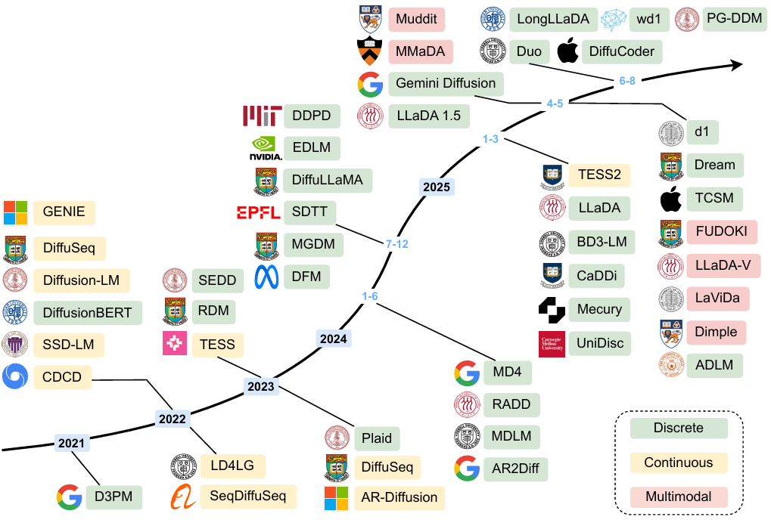
Content
Li, Tianyi et al. “A Survey on Diffusion Language Models.” (2025).

Slide 4
Preliminary
Diffusion
ELBO
Score Matching
CDCD
SEDD
RADD
D3PM
Discrete Flow Matching
DiffusionBERT
GENIE
MD4
LLaDA
Concrete Score Matching
Plaid
Continuous-space diffusion

Slide 5
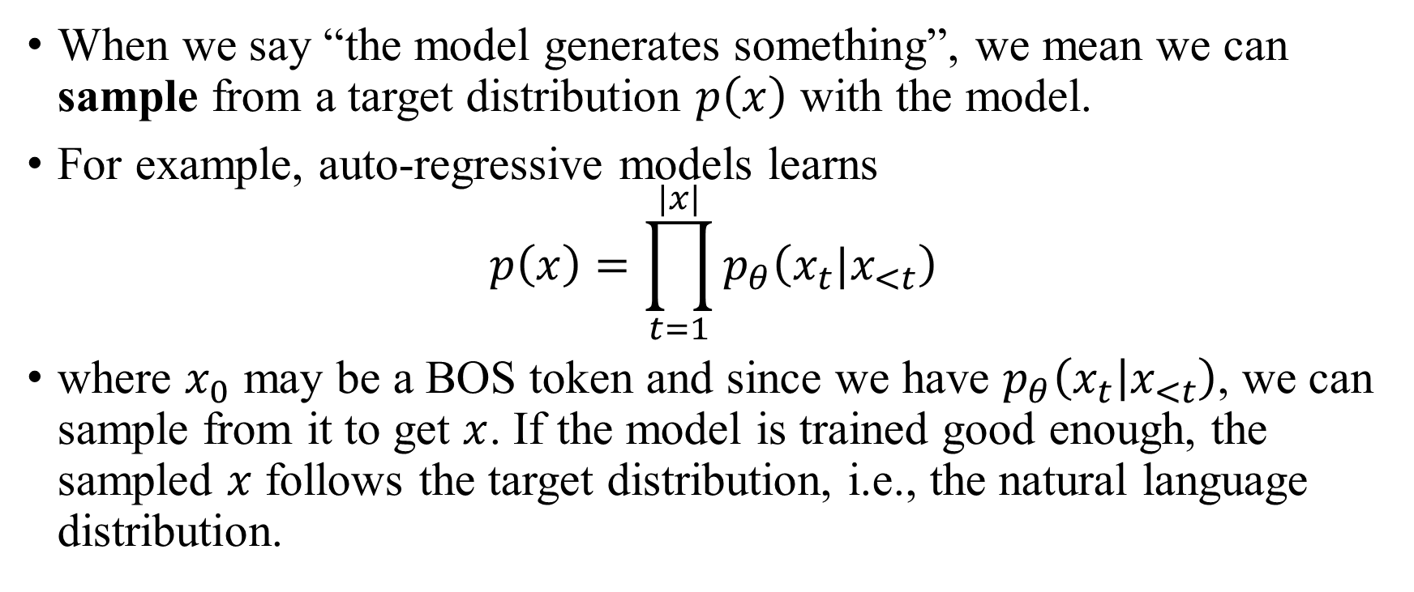
Preliminary: generative modeling
When we say “the model generates something”, we mean we can sample from a target distribution $p\left(x\right)$ with the model.
For example, auto-regressive models learns
$$p\left(x\right)=\prod_{t=1}^{|x|}{p_{θ}\left(x_{t}|x_{<t}\right)}$$
where $x_{0}$ may be a BOS token and since we have $p_{θ}\left(x_{t} | x_{<t}\right)$, we can sample from it to get $x$. If the model is trained good enough, the sampled $x$ follows the target distribution, i.e., the natural language distribution.

Slide 6
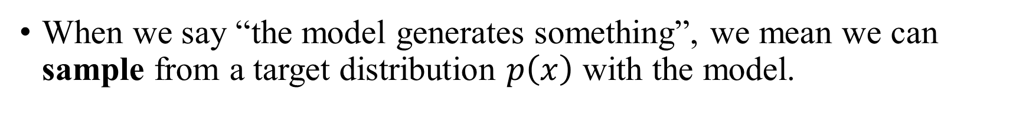
Preliminary: generative modeling
When we say “the model generates something”, we mean we can sample from a target distribution $p\left(x\right)$ with the model.
Nothing
Something meaningful
All-mask
BOS
Gaussian noise
e.t.c.
Text
Images
Videos
e.t.c.

Slide 7
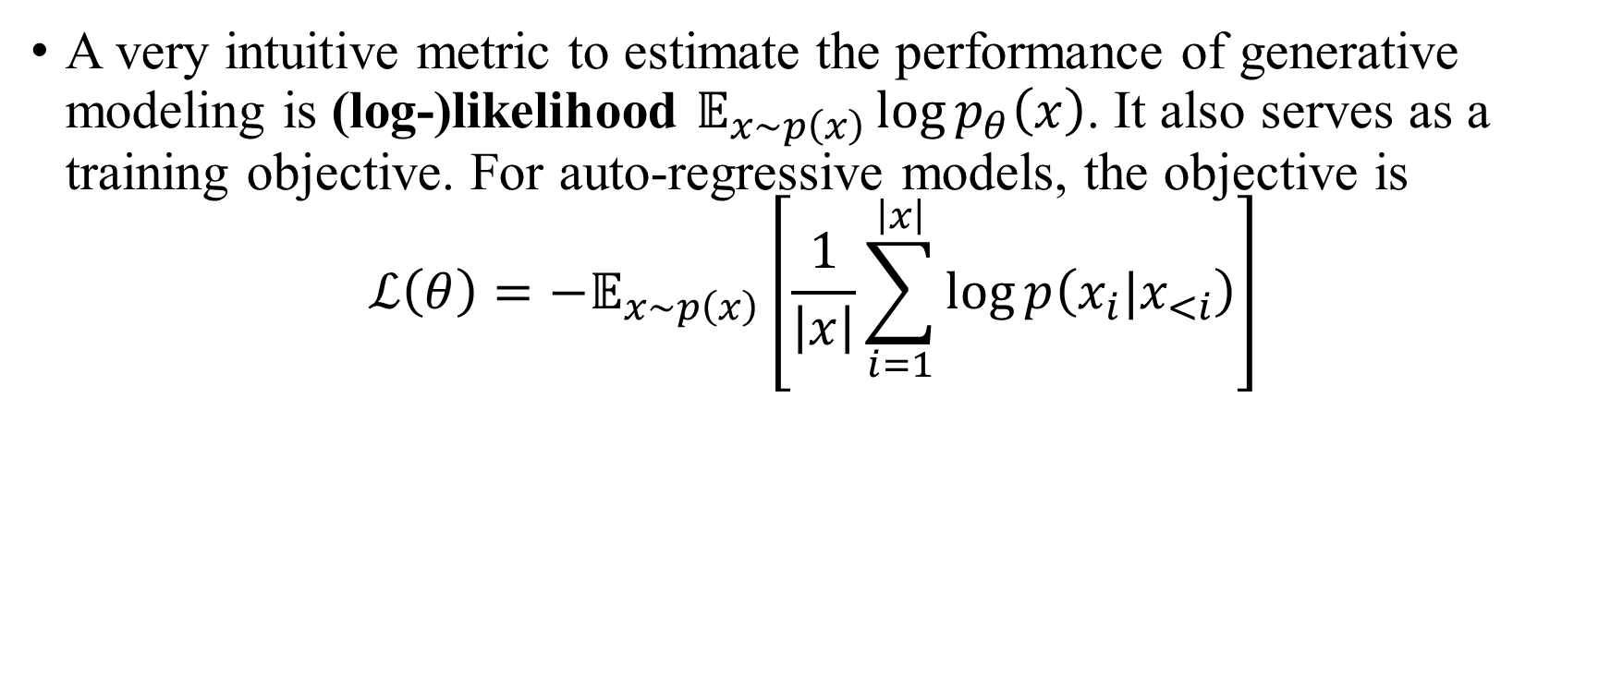
Preliminary: generative modeling
A very intuitive metric to estimate the performance of generative modeling is (log-)likelihood $𝔼_{x∼p\left(x\right)}\log{p_{θ}\left(x\right)}$. It also serves as a training objective. For auto-regressive models, the objective is
$$ℒ\left(θ\right)=−𝔼_{x∼p\left(x\right)}\left[\frac{1}{\left|x\right|}\sum_{i=1}^{\left|x\right|}{\log{p\left(x_{i}|x_{<i}\right)}}\right]$$

Slide 8
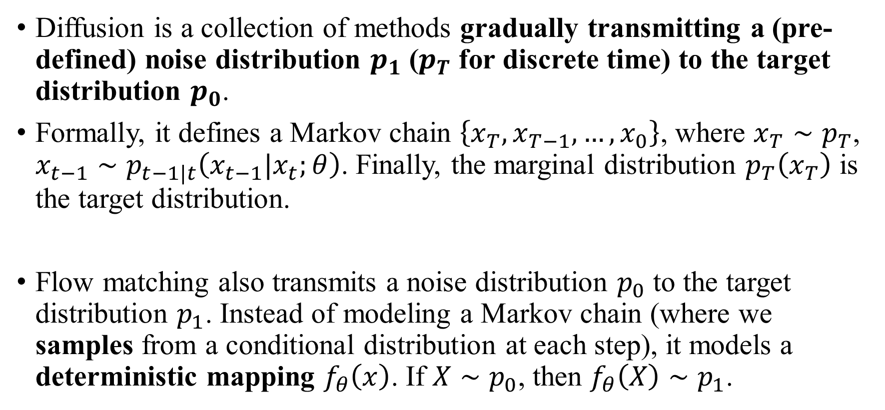
Preliminary: diffusion (and flow matching)
Diffusion is a collection of methods gradually transmitting a (pre-defined) noise distribution $p_{1}$ ($p_{T}$ for discrete time) to the target distribution $p_{0}$.
Formally, it defines a Markov chain $\left\{x_{T},x_{T−1},…,x_{0}\right\}$, where $x_{T}∼p_{T}$, $x_{t−1}∼p_{t−1|t}\left(x_{t−1}|x_{t};θ\right)$. Finally, the marginal distribution $p_{T}\left(x_{T}\right)$ is the target distribution.
Flow matching also transmits a noise distribution $p_{0}$ to the target distribution $p_{1}$. Instead of modeling a Markov chain (where we samples from a conditional distribution at each step), it models a deterministic mapping $f_{θ}\left(x\right)$. If $X∼p_{0}$, then $f_{θ}\left(X\right)∼p_{1}$.

Slide 9
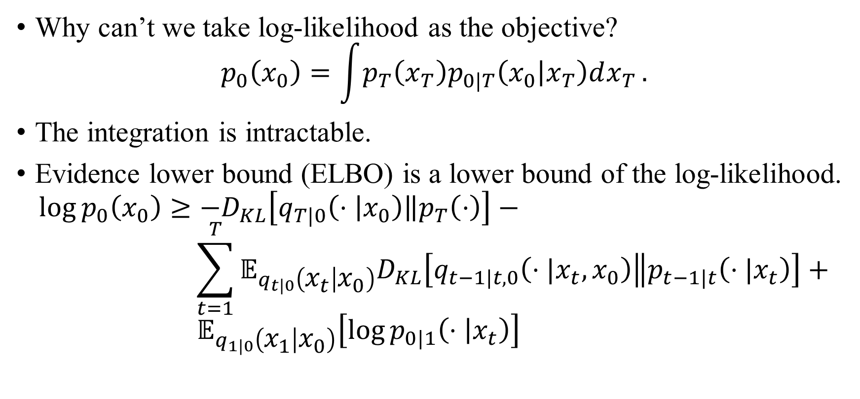
Preliminary: ELBO
Why can’t we take log-likelihood as the objective?
$$p_{0}\left(x_{0}\right)=\int{p_{T}\left(x_{T}\right)p_{0|T}\left(x_{0} | x_{T}\right)dx_{T}}.$$
The integration is intractable.
Evidence lower bound (ELBO) is a lower bound of the log-likelihood.
$$\log{p_{0}\left(x_{0}\right)}≥−D_{KL}\left[q_{T|0}\left(⋅ | x_{0}\right)\left\|p_{T}\left(⋅\right)\right.\right]− \\ \sum_{t=1}^{T}{𝔼_{q_{t|0}\left(x_{t} | x_{0}\right)}D_{KL}\left[q_{t−1|t,0}\left(⋅|x_{t},x_{0}\right)\left\|p_{t−1|t}\left(⋅|x_{t}\right)\right.\right]}+ \\ 𝔼_{q_{1|0}\left(x_{1} | x_{0}\right)}\left[\log{p_{0|1}\left(⋅ | x_{t}\right)}\right]$$

Slide 10

Preliminary: ELBO
$$\log{p_{0}\left(x_{0}\right)=\log{\int{p\left(x_{0:T}\right)dx_{1:T}}}} \\ =\log{\int{q\left(x_{1:T}|x_{0}\right)⋅\frac{p\left(x_{0:T}\right)}{q\left(x_{1:T}|x_{0}\right)}dx_{1:T}}}$$

Slide 11
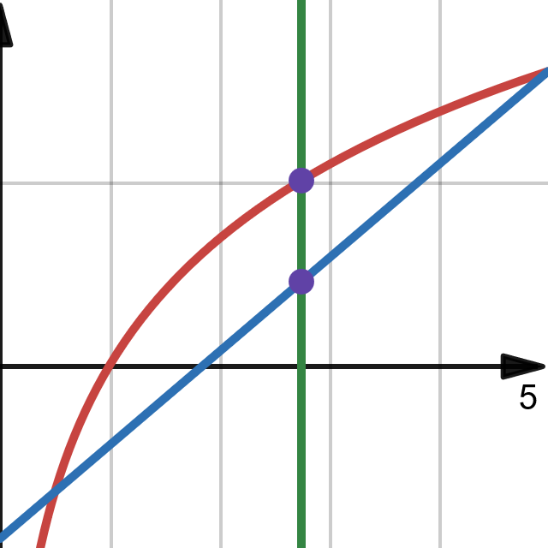

Preliminary: ELBO
$$\log{p_{0}\left(x_{0}\right)=\log{\int{p\left(x_{0:T}\right)dx_{1:T}}}} \\ =\log{\int{q\left(x_{1:T}|x_{0}\right)⋅\frac{p\left(x_{0:T}\right)}{q\left(x_{1:T}|x_{0}\right)}dx_{1:T}}} \\ ≥\int{q\left(x_{1:T} | x_{0}\right)}\log{\frac{p\left(x_{0:T}\right)}{q\left(x_{1:T} | x_{0}\right)}}dx_{1:T}$$
Jensen’s inequality

Slide 12

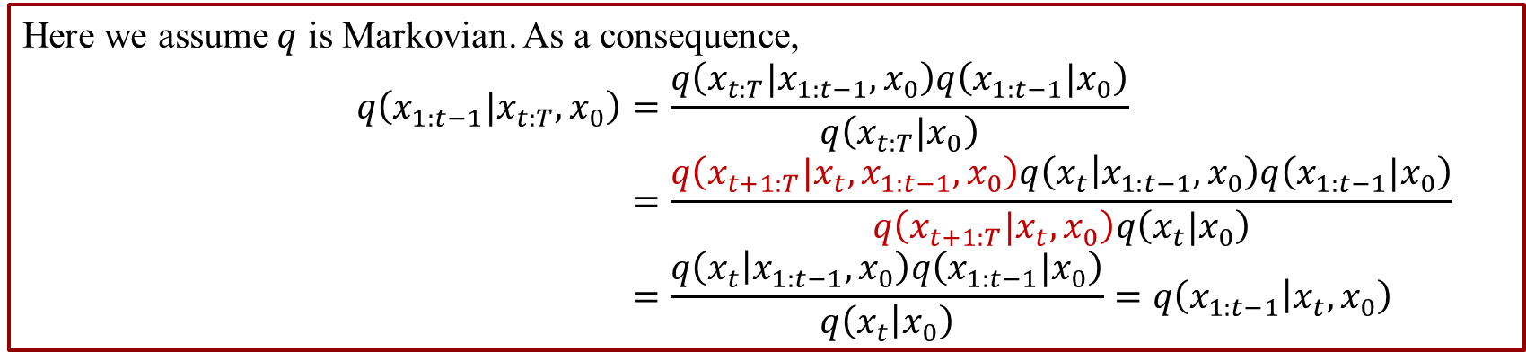
Preliminary: ELBO
$$\log{p_{0}\left(x_{0}\right)}≥\int{q\left(x_{1:T} | x_{0}\right)}\log{\frac{p\left(x_{0:T}\right)}{q\left(x_{1:T} | x_{0}\right)}}dx_{1:T} \\ \log{\frac{p\left(x_{0:T}\right)}{q\left(x_{1:T} | x_{0}\right)}}=\log{p\left(x_{T}\right)}\log{p\left(x_{0} | x_{1}\right)}+\sum_{t=2}^{T}{\log{\frac{p\left(x_{t−1}|x_{t}\right)}{q\left(x_{t−1} | x_{t},x_{0}\right)}}}−\log{q\left(x_{T} | x_{0}\right)}$$
Here we assume $q$ is Markovian. As a consequence,
$$q\left(x_{1:t−1}|x_{t:T},x_{0}\right)=\frac{q\left(x_{t:T}|x_{1:t−1},x_{0}\right)q\left(x_{1:t−1}|x_{0}\right)}{q\left(x_{t:T}|x_{0}\right)} \\ =\frac{q\left(x_{t+1:T}|x_{t},x_{1:t−1},x_{0}\right)q\left(x_{t} | x_{1:t−1},x_{0}\right)q\left(x_{1:t−1}|x_{0}\right)}{q\left(x_{t+1:T}|x_{t},x_{0}\right)q\left(x_{t}|x_{0}\right)} \\ =\frac{q\left(x_{t} | x_{1:t−1},x_{0}\right)q\left(x_{1:t−1}|x_{0}\right)}{q\left(x_{t} | x_{0}\right)}=q\left(x_{1:t−1} | x_{t},x_{0}\right)$$

Slide 13
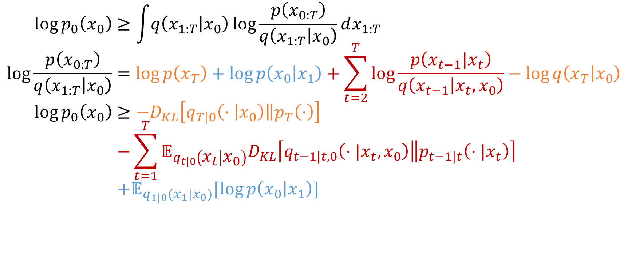
Preliminary: ELBO
$$\log{p_{0}\left(x_{0}\right)}≥\int{q\left(x_{1:T} | x_{0}\right)}\log{\frac{p\left(x_{0:T}\right)}{q\left(x_{1:T} | x_{0}\right)}}dx_{1:T} \\ \log{\frac{p\left(x_{0:T}\right)}{q\left(x_{1:T} | x_{0}\right)}}=\log{p\left(x_{T}\right)}+\log{p\left(x_{0} | x_{1}\right)}+\sum_{t=2}^{T}{\log{\frac{p\left(x_{t−1}|x_{t}\right)}{q\left(x_{t−1} | x_{t},x_{0}\right)}}}−\log{q\left(x_{T} | x_{0}\right)} \\ \log{p_{0}\left(x_{0}\right)≥−D_{KL}\left[q_{T|0}\left(⋅ | x_{0}\right)\left\|p_{T}\left(⋅\right)\right.\right]} \\ −\sum_{t=1}^{T}{𝔼_{q_{t|0}\left(x_{t} | x_{0}\right)}D_{KL}\left[q_{t−1|t,0}\left(⋅|x_{t},x_{0}\right)\left\|p_{t−1|t}\left(⋅|x_{t}\right)\right.\right]} \\ +𝔼_{q_{1|0}(x_{1}|x_{0})}[\log{p\left(x_{0} | x_{1}\right)}]$$

Slide 14



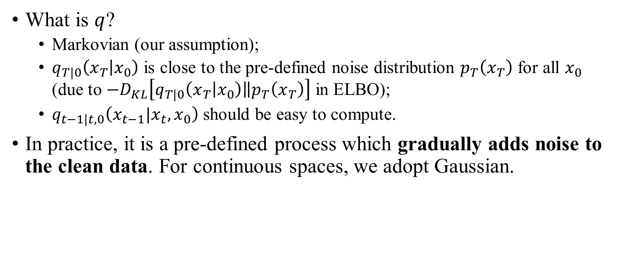






Preliminary: ELBO
What is $q$?
Markovian (our assumption);
$q_{T|0}\left(x_{T} | x_{0}\right)$ is close to the pre-defined noise distribution $p_{T}\left(x_{T}\right)$ for all $x_{0}$ (due to $−D_{KL}\left[q_{T|0}\left(x_{T} | x_{0}\right)\left\|p_{T}\left(x_{T}\right)\right.\right]$ in ELBO);
$q_{t−1|t,0}\left(x_{t−1}|x_{t},x_{0}\right)$ should be easy to compute.
In practice, it is a pre-defined process which gradually adds noise to the clean data. For continuous spaces, we adopt Gaussian.
$$q_{1|0}\left(x_{1}|x_{0}\right)$$
$$q_{2|1}\left(x_{2}|x_{1}\right)$$
$$q_{T|T−1}\left(x_{T}|x_{T−1}\right)$$
$$x_{0}$$
$$x_{1}$$
…
$$x_{T}$$
$$p_{0|1}\left(x_{0}|x_{1}\right)$$
$$p_{1|2}\left(x_{1}|x_{2}\right)$$
$$p_{T−1|T}\left(x_{T−1}|x_{T}\right)$$

Slide 15
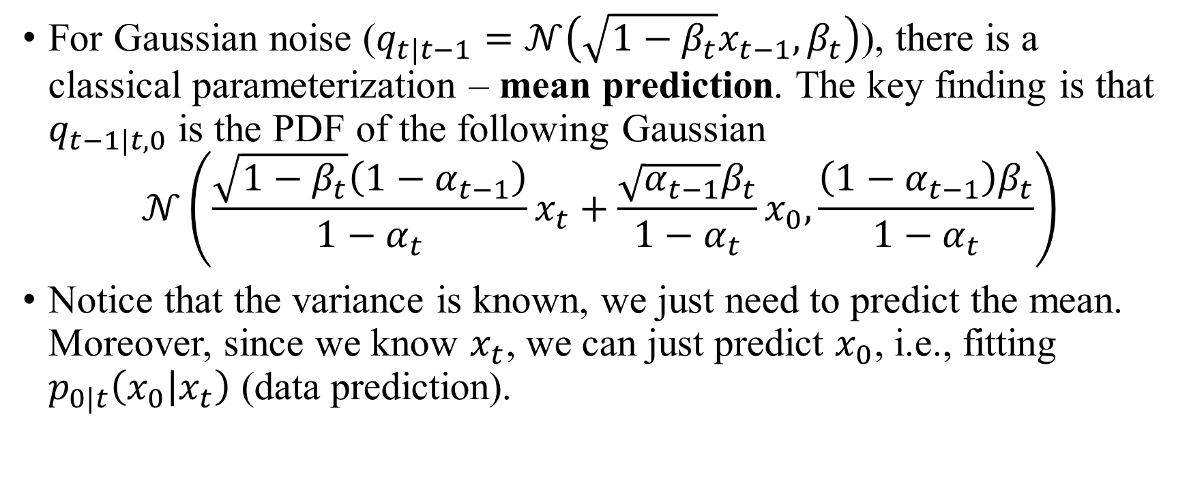
Preliminary: ELBO
For Gaussian noise ($q_{t|t−1}=𝒩\left(\sqrt{1−β_{t}}x_{t−1},β_{t}\right)$), there is a classical parameterization – mean prediction. The key finding is that $q_{t−1|t,0}$ is the PDF of the following Gaussian
$$𝒩\left(\frac{\sqrt{1−β_{t}}\left(1−α_{t−1}\right)}{1−α_{t}}x_{t}+\frac{\sqrt{α_{t−1}}β_{t}}{1−α_{t}}x_{0},\frac{\left(1−α_{t−1}\right)β_{t}}{1−α_{t}}\right)$$
Notice that the variance is known, we just need to predict the mean. Moreover, since we know $x_{t}$, we can just predict $x_{0}$, i.e., fitting $p_{0|t}\left(x_{0} | x_{t}\right)$ (data prediction).

Slide 16
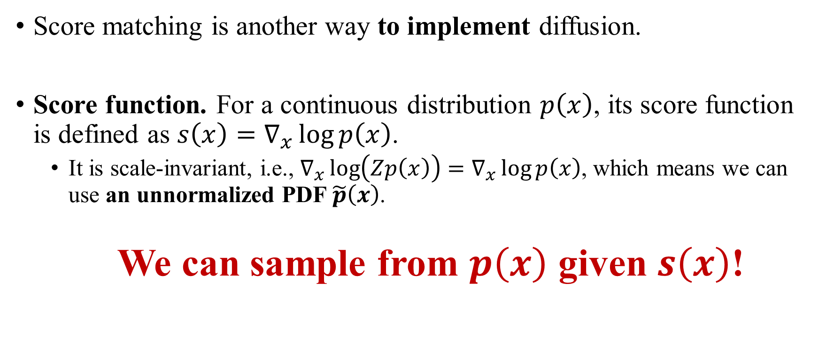
Preliminary: score matching
Score matching is another way to implement diffusion.
Score function. For a continuous distribution $p\left(x\right)$, its score function is defined as $s\left(x\right)=∇_{x}\log{p\left(x\right)}$.
It is scale-invariant, i.e., $∇_{x}\log\left(Zp\left(x\right)\right)=∇_{x}\log{p\left(x\right)}$, which means we can use an unnormalized PDF $\tilde{p}\left(x\right)$.
We can sample from $p\left(x\right)$ given $s\left(x\right)$!

Slide 17

Preliminary: score matching
We can sample from $p\left(x\right)$ given $s\left(x\right)$, which is supported by the following fact – the stable distribution of the following Langevin dynamics is $p\left(t\right)$:
$$dx=∇_{x}\log{p\left(x\right)}dt+\sqrt{2}dW_{t}.$$

Slide 18
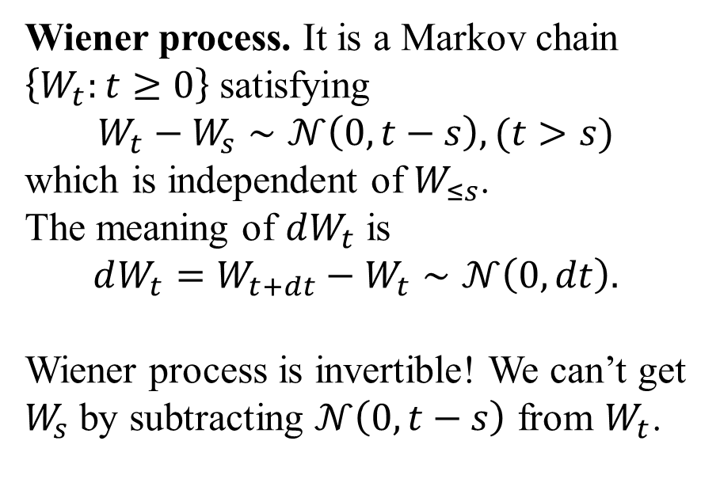
Preliminary: score matching
We can sample from $p\left(x\right)$ given $s\left(x\right)$, which is supported by the following fact – the stable distribution of the following Langevin dynamics is $p\left(t\right)$:
$$dx=∇_{x}\log{p\left(x\right)}dt+\sqrt{2}dW_{t}.$$
Wiener process. It is a Markov chain $\left\{W_{t}:t≥0\right\}$ satisfying
$$W_{t}−W_{s}∼𝒩\left(0,t−s\right), (t>s)$$
which is independent of $W_{≤s}$.
The meaning of $dW_{t}$ is
$$dW_{t}=W_{t+dt}−W_{t}∼𝒩\left(0,dt\right).$$
Wiener process is invertible! We can’t get $W_{s}$ by subtracting $𝒩\left(0,t−s\right)$ from $W_{t}$.

Slide 19
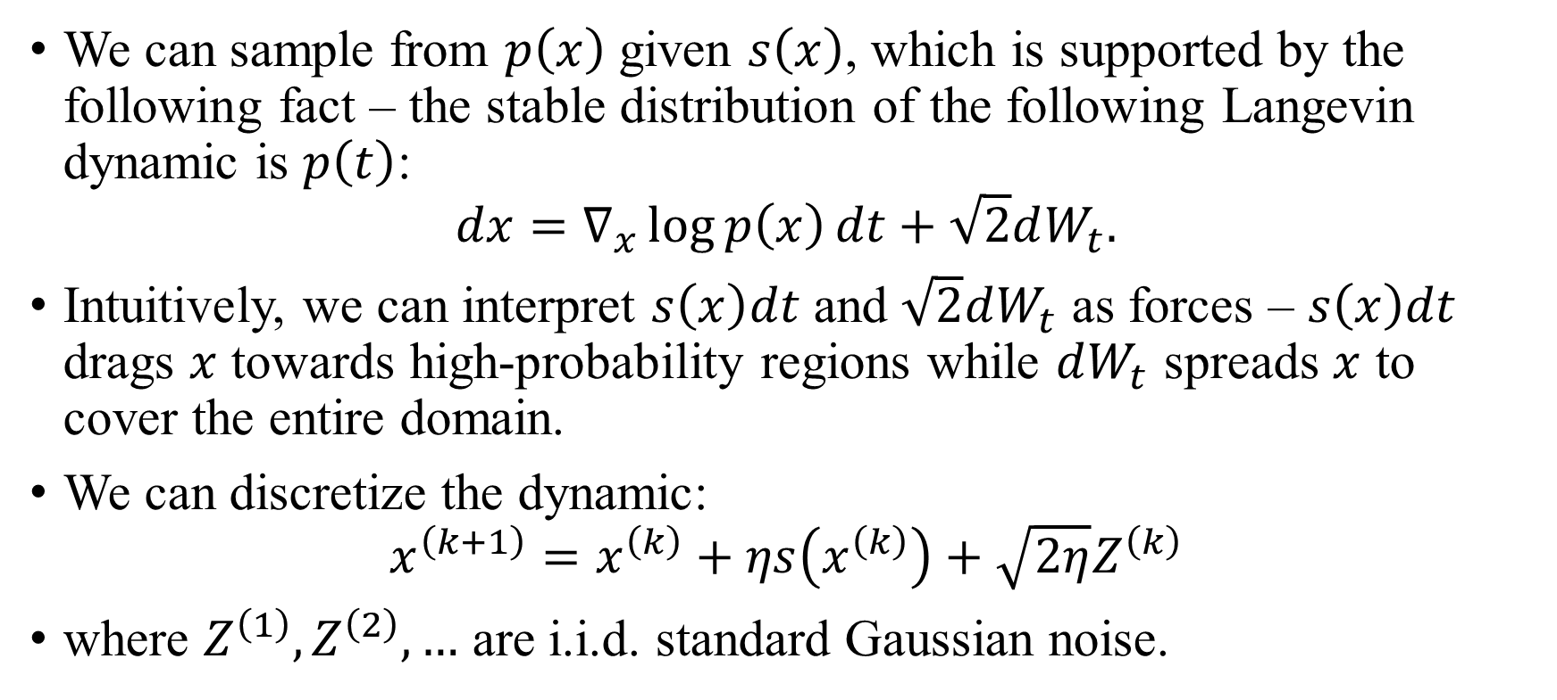
Preliminary: score matching
We can sample from $p\left(x\right)$ given $s\left(x\right)$, which is supported by the following fact – the stable distribution of the following Langevin dynamic is $p\left(t\right)$:
$$dx=∇_{x}\log{p\left(x\right)}dt+\sqrt{2}dW_{t}.$$
Intuitively, we can interpret $s\left(x\right)dt$ and $\sqrt{2}dW_{t}$ as forces – $s\left(x\right)dt$ drags $x$ towards high-probability regions while $dW_{t}$ spreads $x$ to cover the entire domain.
We can discretize the dynamic:
$$x^{\left(k+1\right)}=x^{\left(k\right)}+ηs\left(x^{\left(k\right)}\right)+\sqrt{2η}Z^{\left(k\right)}$$
where $Z^{\left(1\right)},Z^{\left(2\right)},…$ are i.i.d. standard Gaussian noise.

Slide 20
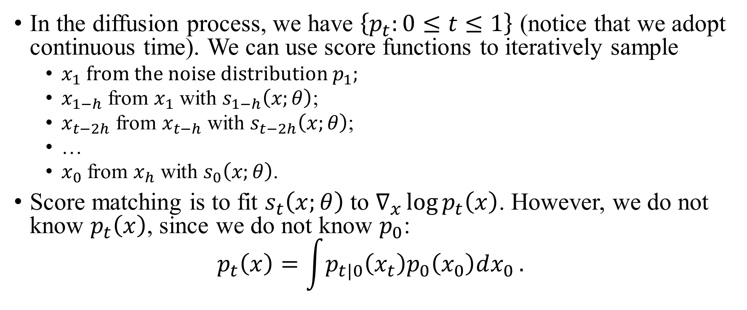
Preliminary: score matching
In the diffusion process, we have $\left\{p_{t}:0≤t≤1\right\}$ (notice that we adopt continuous time). We can use score functions to iteratively sample
$x_{1}$ from the noise distribution $p_{1}$;
$x_{1−h}$ from $x_{1}$ with $s_{1−h}\left(x;θ\right)$;
$x_{t−2h}$ from $x_{t−h}$ with $s_{t−2h}\left(x;θ\right)$;
…
$x_{0}$ from $x_{h}$ with $s_{0}\left(x;θ\right)$.
Score matching is to fit $s_{t}\left(x;θ\right)$ to $∇_{x}\log{p_{t}\left(x\right)}$. However, we do not know $p_{t}\left(x\right)$, since we do not know $p_{0}$:
$$p_{t}\left(x\right)=\int{p_{t|0}\left(x_{t}\right)p_{0}\left(x_{0}\right)dx_{0}}.$$

Slide 21
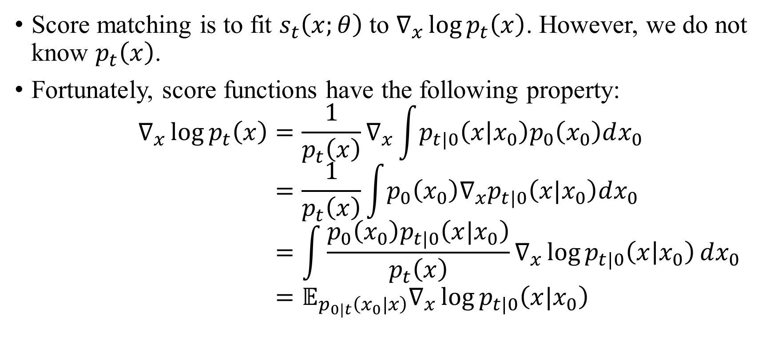
Preliminary: score matching
Score matching is to fit $s_{t}\left(x;θ\right)$ to $∇_{x}\log{p_{t}\left(x\right)}$. However, we do not know $p_{t}\left(x\right)$.
Fortunately, score functions have the following property:
$$∇_{x}\log{p_{t}\left(x\right)}=\frac{1}{p_{t}\left(x\right)}∇_{x}\int{p_{t|0}\left(x | x_{0}\right)p_{0}\left(x_{0}\right)dx_{0}} \\ =\frac{1}{p_{t}\left(x\right)}\int{p_{0}\left(x_{0}\right)∇_{x}p_{t|0}\left(x|x_{0}\right)dx_{0}} \\ =\int{\frac{p_{0}\left(x_{0}\right)p_{t|0}\left(x|x_{0}\right)}{p_{t}\left(x\right)}∇_{x}\log{p_{t|0}\left(x | x_{0}\right)}dx_{0}} \\ =𝔼_{p_{0|t}\left(x_{0}|x\right)}∇_{x}\log{p_{t|0}\left(x|x_{0}\right)}$$

Slide 22
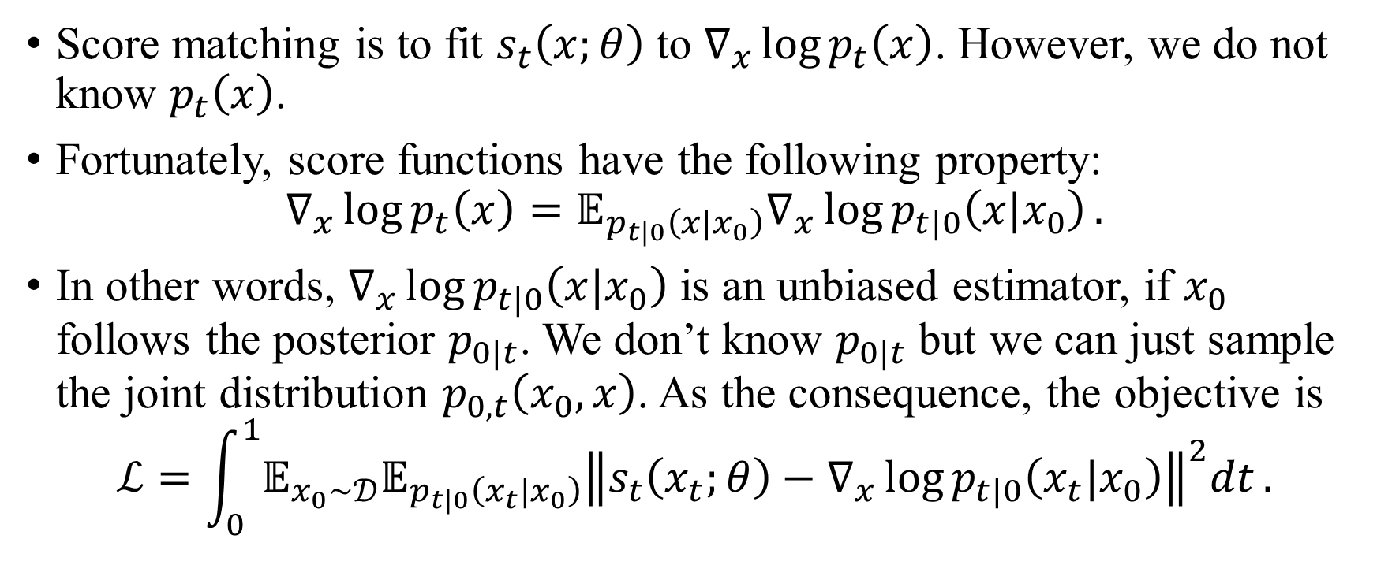
Preliminary: score matching
Score matching is to fit $s_{t}\left(x;θ\right)$ to $∇_{x}\log{p_{t}\left(x\right)}$. However, we do not know $p_{t}\left(x\right)$.
Fortunately, score functions have the following property:
$$∇_{x}\log{p_{t}\left(x\right)}=𝔼_{p_{t|0}\left(x|x_{0}\right)}∇_{x}\log{p_{t|0}\left(x|x_{0}\right)}.$$
In other words, $∇_{x}\log{p_{t|0}\left(x|x_{0}\right)}$ is an unbiased estimator, if $x_{0}$ follows the posterior $p_{0|t}$. We don’t know $p_{0|t}$ but we can just sample the joint distribution $p_{0,t}\left(x_{0},x\right)$. As the consequence, the objective is
$$ℒ=\int_{0}^{1}{𝔼_{x_{0}∼𝒟}𝔼_{p_{t|0}\left(x_{t}|x_{0}\right)}{\left\|s_{t}\left(x_{t};θ\right)−∇_{x}\log{p_{t|0}\left(x_{t}|x_{0}\right)}\right\|}^{2}dt}.$$

Slide 23
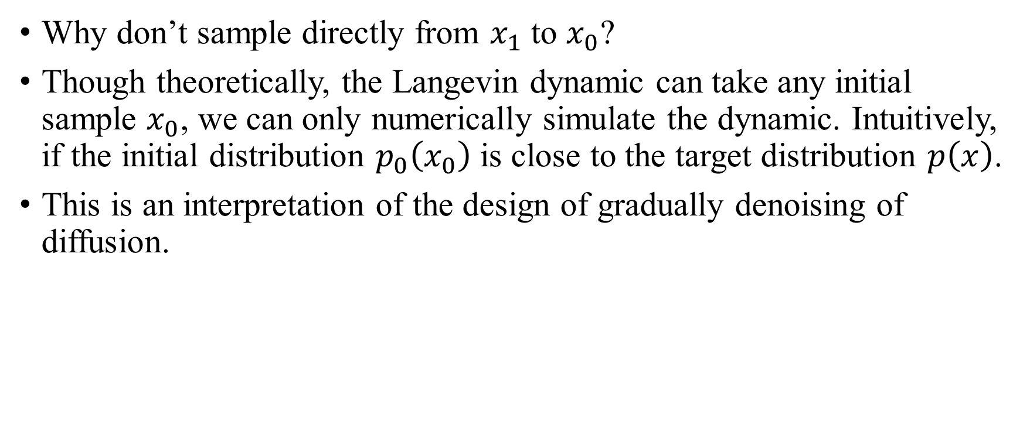
Preliminary: score matching
Why don’t sample directly from $x_{1}$ to $x_{0}$?
Though theoretically, the Langevin dynamic can take any initial sample $x_{0}$, we can only numerically simulate the dynamic. Intuitively, if the initial distribution $p_{0}\left(x_{0}\right)$ is close to the target distribution $p\left(x\right)$.
This is an interpretation of the design of gradually denoising of diffusion.

Slide 24
GENIE
Diffusion
ELBO
Score Matching
CDCD
SEDD
RADD
D3PM
Discrete Flow Matching
DiffusionBERT
GENIE
MD4
LLaDA
Concrete Score Matching
Plaid
Text Generation with Diffusion Language Models: A Pre-training Approach with Continuous Paragraph Denoise

Slide 25
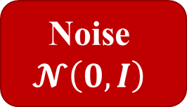
GENIE
GENIE is a standard noise-prediction diffusion model. It is an encoder-decoder model. While the encoder-decoder architecture is deprecated recently, it is an early work that focus on conditional generation.
Language tokens are discrete, but embedding is continuous.
Noise
$$𝓝\left(0,I\right)$$
Denoised vector
Embedding
Token sequence
diffusion
round
detokenize

Slide 26

GENIE: Pretrain
Another feature of GENIE is its pretraining method, which is similar to BERT pretraining.
Supervise
Paragraph
Noise
Decoder
Denoised
sequence
Clean sequence
MASK
Encoder
30% of the total length
Embedding $H_{s}$

Slide 27
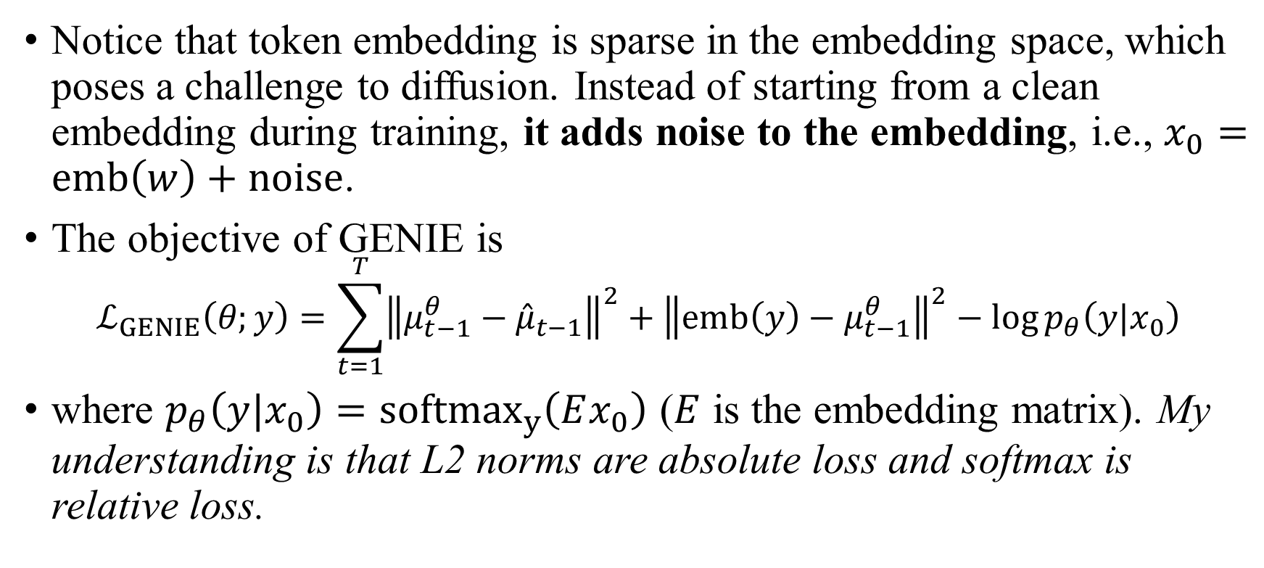
GENIE: Details
Notice that token embedding is sparse in the embedding space, which poses a challenge to diffusion. Instead of starting from a clean embedding during training, it adds noise to the embedding, i.e., $x_{0}=emb\left(w\right)+noise$.
The objective of GENIE is
$$ℒ_{GENIE}\left(θ;y\right)=\sum_{t=1}^{T}{{\left\|μ_{t−1}^{θ}−{\hat{μ}}_{t−1}\right\|}^{2}}+{\left\|emb\left(y\right)−μ_{t−1}^{θ}\right\|}^{2}−\log{p_{θ}\left(y|x_{0}\right)}$$
where $p_{θ}\left(y|x_{0}\right)={softmax}_{y}\left(Ex_{0}\right)$ ($E$ is the embedding matrix). My understanding is that L2 norms are absolute loss and softmax is relative loss.

Slide 28
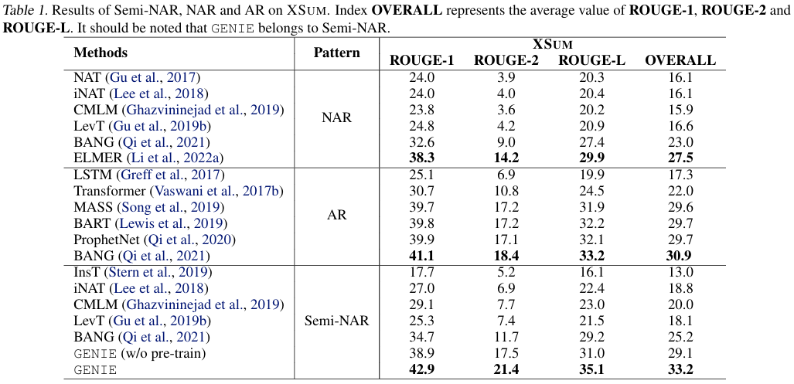
GENIE: Results

Slide 29
D3PM
Diffusion
ELBO
Score Matching
CDCD
SEDD
RADD
D3PM
Discrete Flow Matching
DiffusionBERT
GENIE
MD4
LLaDA
Concrete Score Matching
Plaid
Structured Denoising Diffusion Models in Discrete State-Spaces

Slide 30
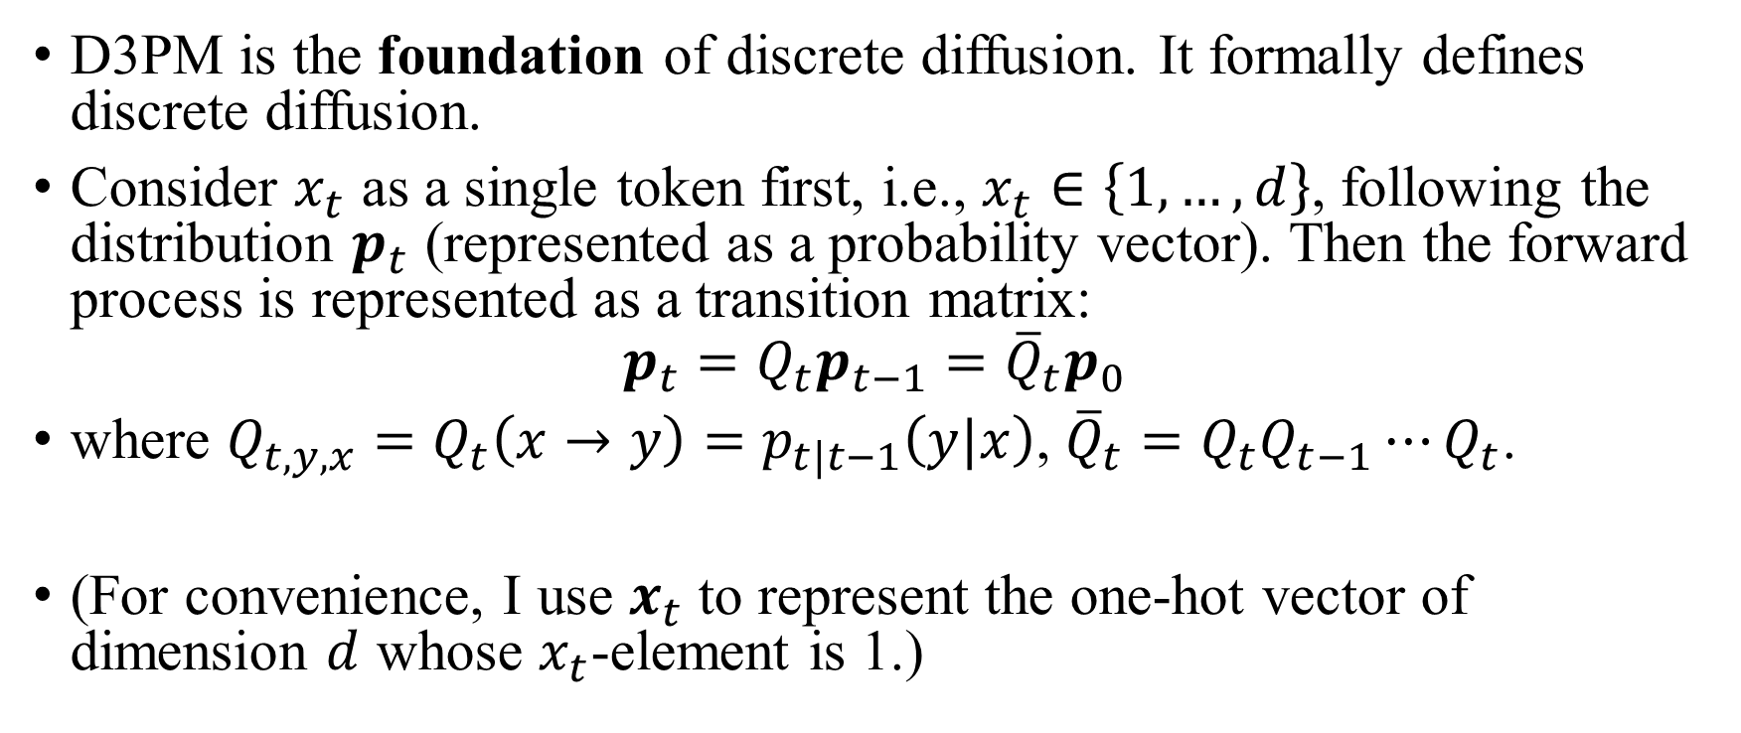
D3PM: Notations
D3PM is the foundation of discrete diffusion. It formally defines discrete diffusion.
Consider $x_{t}$ as a single token first, i.e., $x_{t}∈\left\{1,…,d\right\}$, following the distribution $p_{t}$ (represented as a probability vector). Then the forward process is represented as a transition matrix:
$$p_{t}=Q_{t}p_{t−1}={\overline{Q}}_{t}p_{0}$$
where $Q_{t,y,x}=Q_{t}\left(x→y\right)=p_{t|t−1}\left(y|x\right)$, ${\overline{Q}}_{t}=Q_{t}Q_{t−1}⋯Q_{t}$.
(For convenience, I use $x_{t}$ to represent the one-hot vector of dimension $d$ whose $x_{t}$-element is 1.)

Slide 31
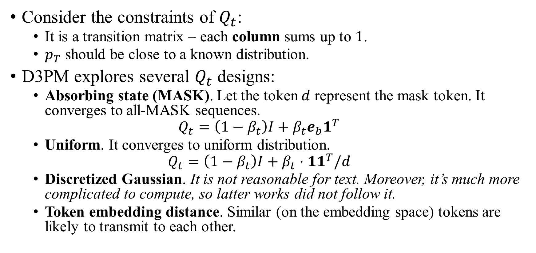
D3PM: Notations
Consider the constraints of $Q_{t}$:
It is a transition matrix – each column sums up to $1$.
$p_{T}$ should be close to a known distribution.
D3PM explores several $Q_{t}$ designs:
Absorbing state (MASK). Let the token $d$ represent the mask token. It converges to all-MASK sequences.
$$Q_{t}=\left(1−β_{t}\right)I+β_{t}e_{b}1^{T}$$
Uniform. It converges to uniform distribution.
$$Q_{t}=\left(1−β_{t}\right)I+β_{t}⋅11^{T}/d$$
Discretized Gaussian. It is not reasonable for text. Moreover, it’s much more complicated to compute, so latter works did not follow it.
Token embedding distance. Similar (on the embedding space) tokens are likely to transmit to each other.
A.2.4

Slide 32
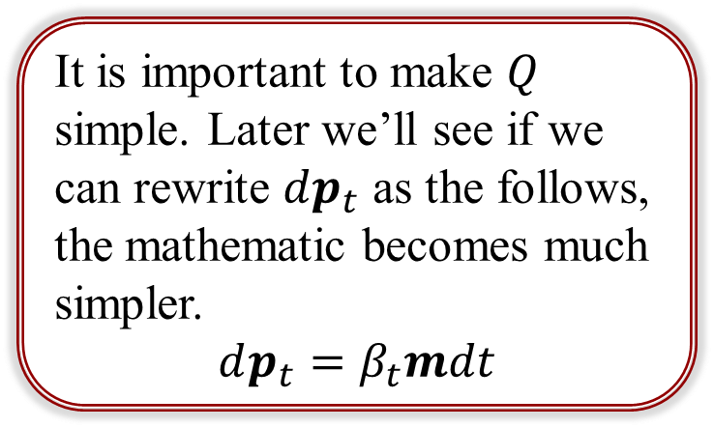
D3PM: Notations
Consider the constraints of $Q_{t}$:
It is a transition matrix – each column sums up to $1$.
$p_{T}$ should be close to a known distribution.
D3PM explores several $Q_{t}$ designs:
Absorbing state (MASK). Let the token $d$ represent the mask token. It converges to all-MASK sequences.
$$Q_{t}=\left(1−β_{t}\right)I+β_{t}e_{b}1^{T}$$
Uniform. It converges to uniform distribution.
$$Q_{t}=\left(1−β_{t}\right)I+β_{t}⋅11^{T}/d$$
Discretized Gaussian. It is not reasonable for text. Moreover, it’s much more complicated to compute, so latter works did not follow it.
Token embedding distance. Similar (on the embedding space) tokens are likely to transmit to each other.
It is important to make $Q$ simple. Later we’ll see if we can rewrite $dp_{t}$ as the follows, the mathematic becomes much simpler.
$$dp_{t}=β_{t}mdt$$
A.2.4

Slide 33
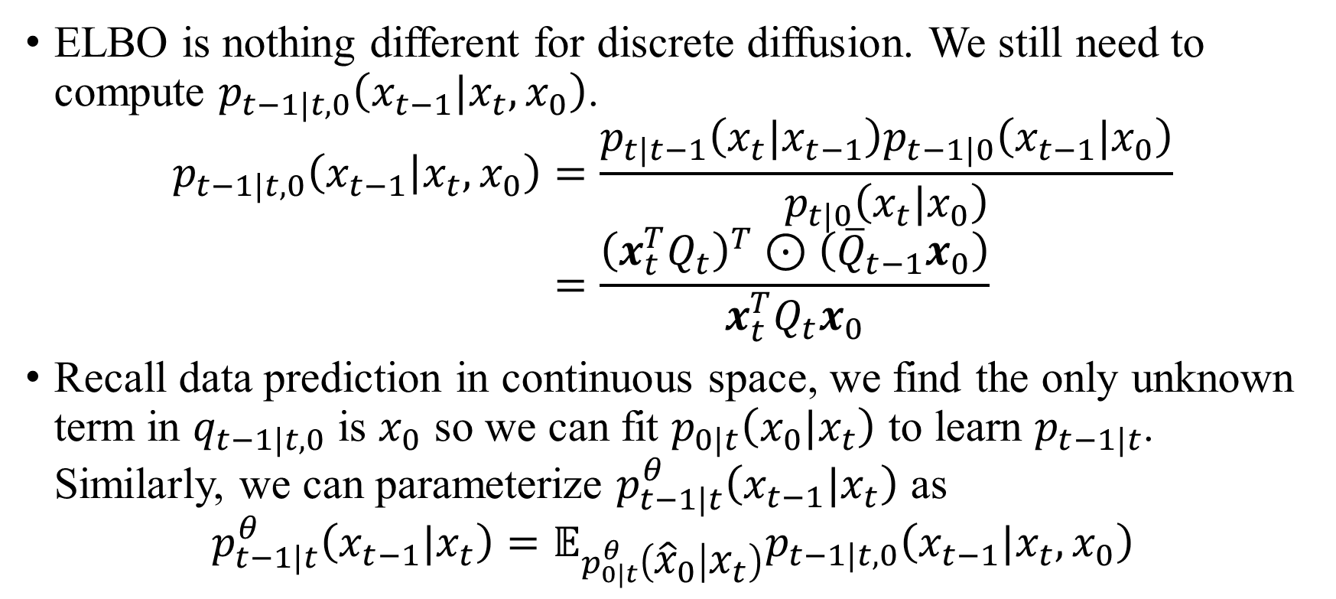
D3PM: Notations
ELBO is nothing different for discrete diffusion. We still need to compute $p_{t−1|t,0}\left(x_{t−1}|x_{t},x_{0}\right)$.
$$p_{t−1|t,0}\left(x_{t−1} | x_{t},x_{0}\right)=\frac{p_{t|t−1}\left(x_{t}|x_{t−1}\right)p_{t−1|0}\left(x_{t−1}|x_{0}\right)}{p_{t|0}\left(x_{t}|x_{0}\right)} \\ =\frac{{\left(x_{t}^{T}Q_{t}\right)}^{T}⊙\left({\overline{Q}}_{t−1}x_{0}\right)}{x_{t}^{T}Q_{t}x_{0}}$$
Recall data prediction in continuous space, we find the only unknown term in $q_{t−1|t,0}$ is $x_{0}$ so we can fit $p_{0|t}\left(x_{0}|x_{t}\right)$ to learn $p_{t−1|t}$. Similarly, we can parameterize $p_{t−1|t}^{θ}\left(x_{t−1}|x_{t}\right)$ as
$$p_{t−1|t}^{θ}\left(x_{t−1}|x_{t}\right)=𝔼_{p_{0|t}^{θ}\left({\hat{x}}_{0} | x_{t}\right)}p_{t−1|t,0}\left(x_{t−1}|x_{t},x_{0}\right)$$
(3)
(4)

Slide 34
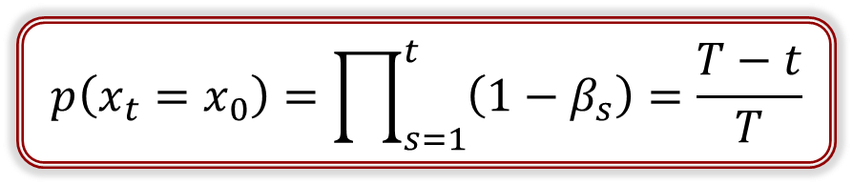
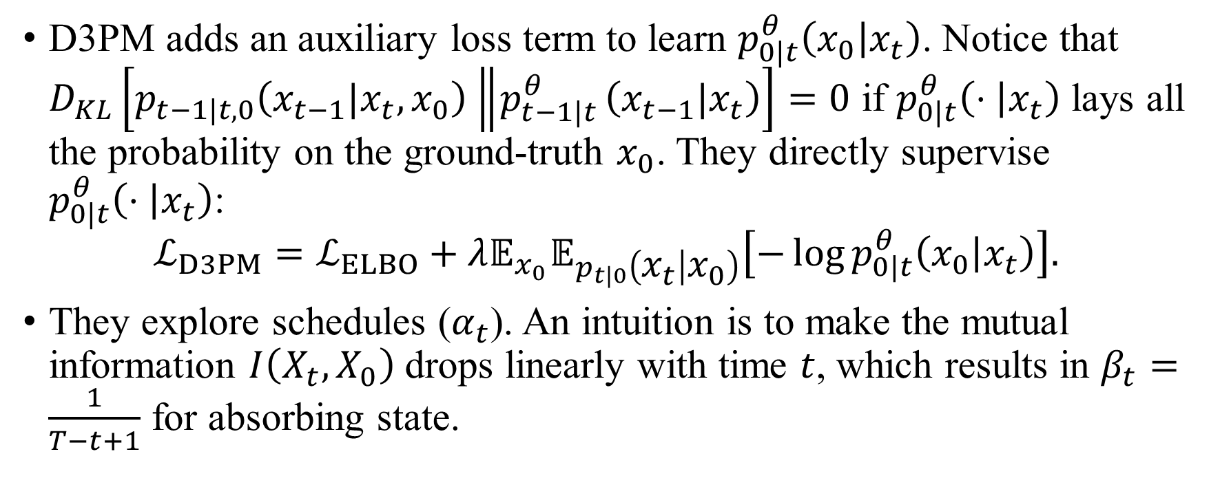
D3PM: Details
D3PM adds an auxiliary loss term to learn $p_{0|t}^{θ}\left(x_{0} | x_{t}\right)$. Notice that $D_{KL}\left[p_{t−1|t,0}\left(x_{t−1}|x_{t},x_{0}\right)\left\|p_{t−1|t}^{θ}\right.\left(x_{t−1}|x_{t}\right)\right]=0$ if $p_{0|t}^{θ}\left(⋅ | x_{t}\right)$ lays all the probability on the ground-truth $x_{0}$. They directly supervise $p_{0|t}^{θ}\left(⋅ | x_{t}\right)$:
$$ℒ_{D3PM}=ℒ_{ELBO}+λ𝔼_{x_{0}}𝔼_{p_{t|0}\left(x_{t} | x_{0}\right)}\left[−\log{p_{0|t}^{θ}\left(x_{0} | x_{t}\right)}\right].$$
They explore schedules ($α_{t}$). An intuition is to make the mutual information $I\left(X_{t},X_{0}\right)$ drops linearly with time $t$, which results in $β_{t}=\frac{1}{T−t+1}$ for absorbing state.
(5)
$$p\left(x_{t}=x_{0}\right)=\prod_{s=1}^{t}{\left(1−β_{s}\right)}=\frac{T−t}{T}$$

Slide 35
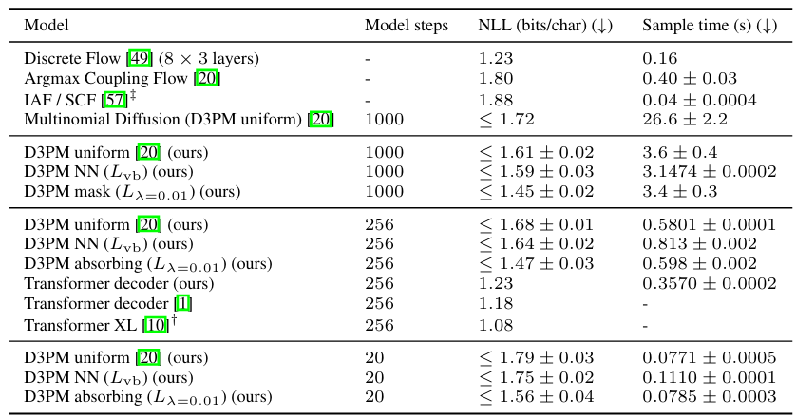
D3PM: Results on text8
Model
T5-like Transformer with 12 layers (70M).

Slide 36
DiffusionBERT
Diffusion
ELBO
Score Matching
CDCD
SEDD
RADD
D3PM
Discrete Flow Matching
DiffusionBERT
GENIE
MD4
LLaDA
Concrete Score Matching
Plaid
DiffusionBERT: Improving Generative Masked Language Models with Diffusion Models

Slide 37
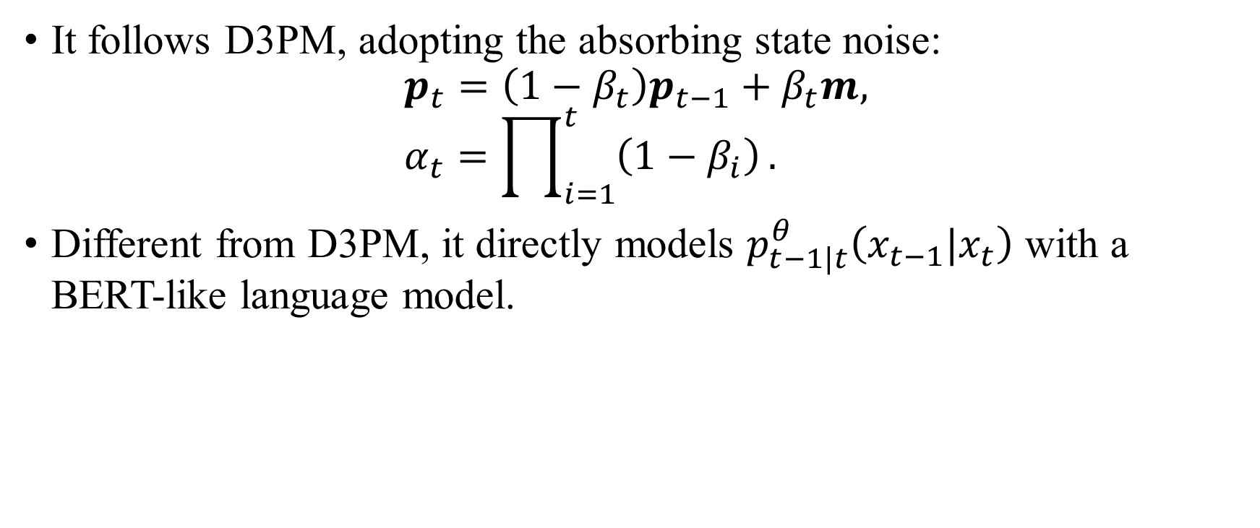
DiffusionBERT: Overall
It follows D3PM, adopting the absorbing state noise:
$$p_{t}=\left(1−β_{t}\right)p_{t−1}+β_{t}m, \\ α_{t}=\prod_{i=1}^{t}{\left(1−β_{i}\right)}.$$
Different from D3PM, it directly models $p_{t−1|t}^{θ}\left(x_{t−1}|x_{t}\right)$ with a BERT-like language model.

Slide 38
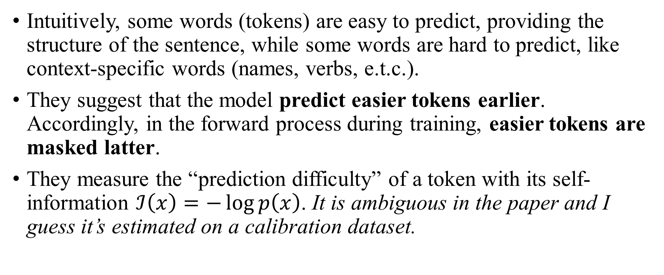
DiffusionBERT: Spindle noise schedule
Intuitively, some words (tokens) are easy to predict, providing the structure of the sentence, while some words are hard to predict, like context-specific words (names, verbs, e.t.c.).
They suggest that the model predict easier tokens earlier. Accordingly, in the forward process during training, easier tokens are masked latter.
They measure the “prediction difficulty” of a token with its self-information $ℐ\left(x\right)=−\log{p\left(x\right)}$. It is ambiguous in the paper and I guess it’s estimated on a calibration dataset.

Slide 39
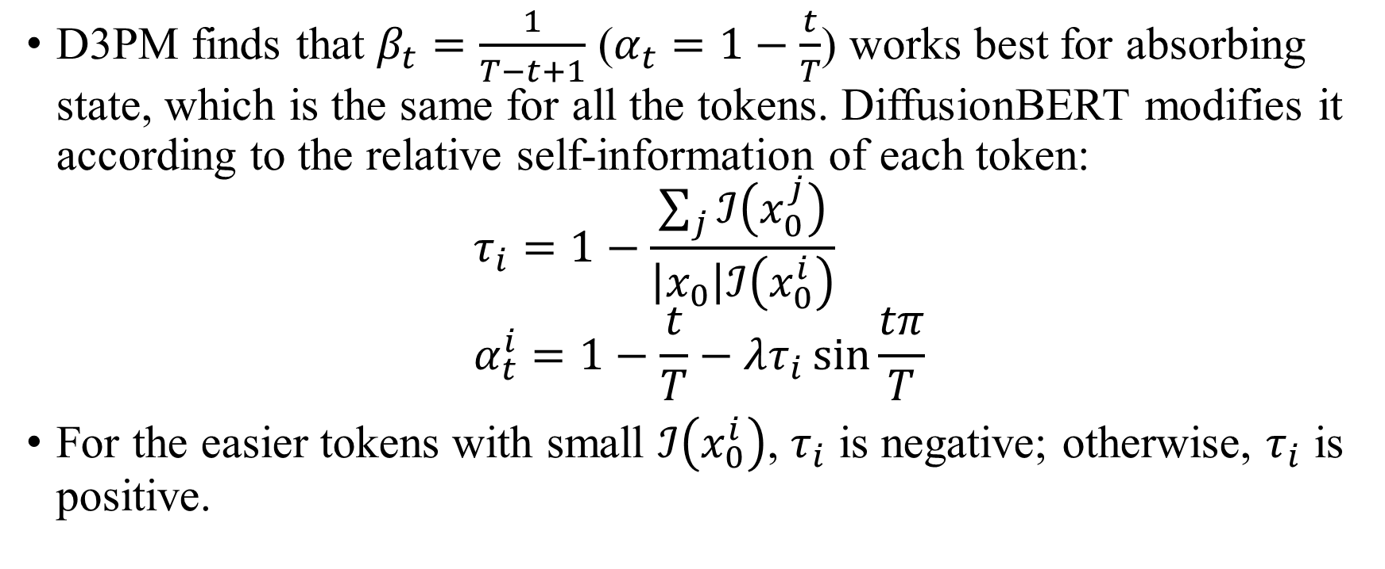
DiffusionBERT: Spindle noise schedule
D3PM finds that $β_{t}=\frac{1}{T−t+1}$ ($α_{t}=1−\frac{t}{T}$) works best for absorbing state, which is the same for all the tokens. DiffusionBERT modifies it according to the relative self-information of each token:
$$τ_{i}=1−\frac{\sum_{j}{ℐ\left(x_{0}^{j}\right)}}{\left|x_{0}\right|ℐ\left(x_{0}^{i}\right)} \\ α_{t}^{i}=1−\frac{t}{T}−λτ_{i}\sin{\frac{tπ}{T}}$$
For the easier tokens with small $ℐ\left(x_{0}^{i}\right)$, $τ_{i}$ is negative; otherwise, $τ_{i}$ is positive.
(10)

Slide 40
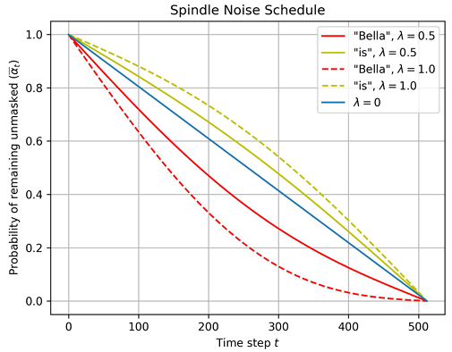


DiffusionBERT: Spindle noise schedule
For the easier tokens with small $ℐ\left(x_{0}^{i}\right)$, $τ_{i}$ is negative; otherwise, $τ_{i}$ is positive. This results in the following schedules.
For instance, in the sentence “Bella is sitting over there.”, “Bella” is the most informative word. Thus it is encouraged to be masked at the early stage so that our model learns to recover it in the last place.
Fig. 2

Slide 41
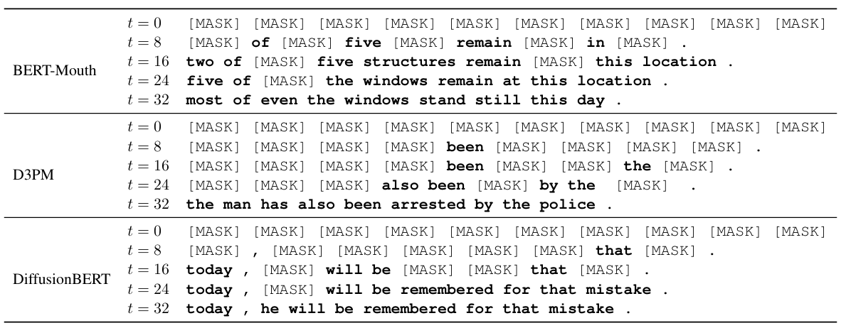
DiffusionBERT: Spindle noise schedule
Table 1
Spindle noise schedule allows DiffusionBERT to predicts easier tokens earlier.

Slide 42
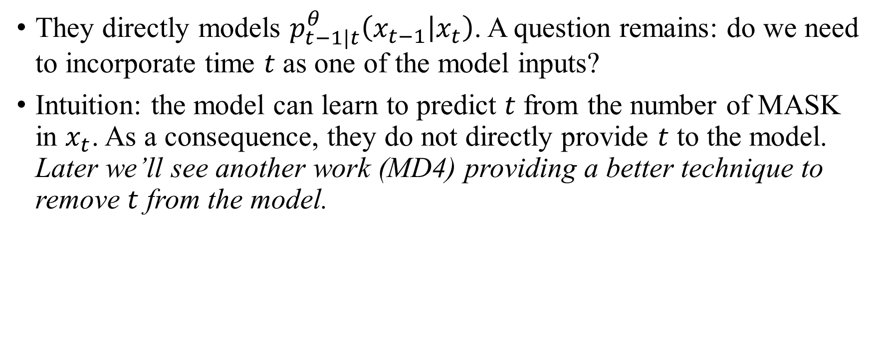
DiffusionBERT: Time-Agnostic Decoding
They directly models $p_{t−1|t}^{θ}\left(x_{t−1} | x_{t}\right)$. A question remains: do we need to incorporate time $t$ as one of the model inputs?
Intuition: the model can learn to predict $t$ from the number of MASK in $x_{t}$. As a consequence, they do not directly provide $t$ to the model. Later we’ll see another work (MD4) providing a better technique to remove $t$ from the model.

Slide 43
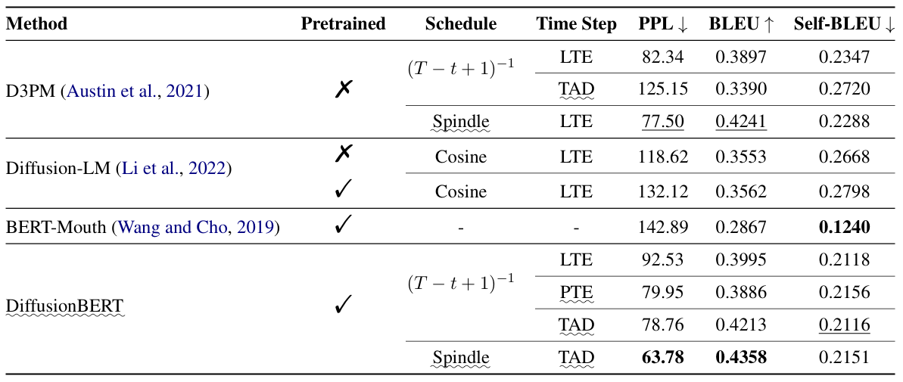
DiffusionBERT: Results on LM1B
Table 2
Transformer XL: PPL=21.8

Slide 44
MD4
Diffusion
ELBO
Score Matching
CDCD
SEDD
RADD
D3PM
Discrete Flow Matching
DiffusionBERT
GENIE
MD4
LLaDA
Concrete Score Matching
Plaid
DiffusionBERT: Improving Generative Masked Language Models with Diffusion Models

Slide 45
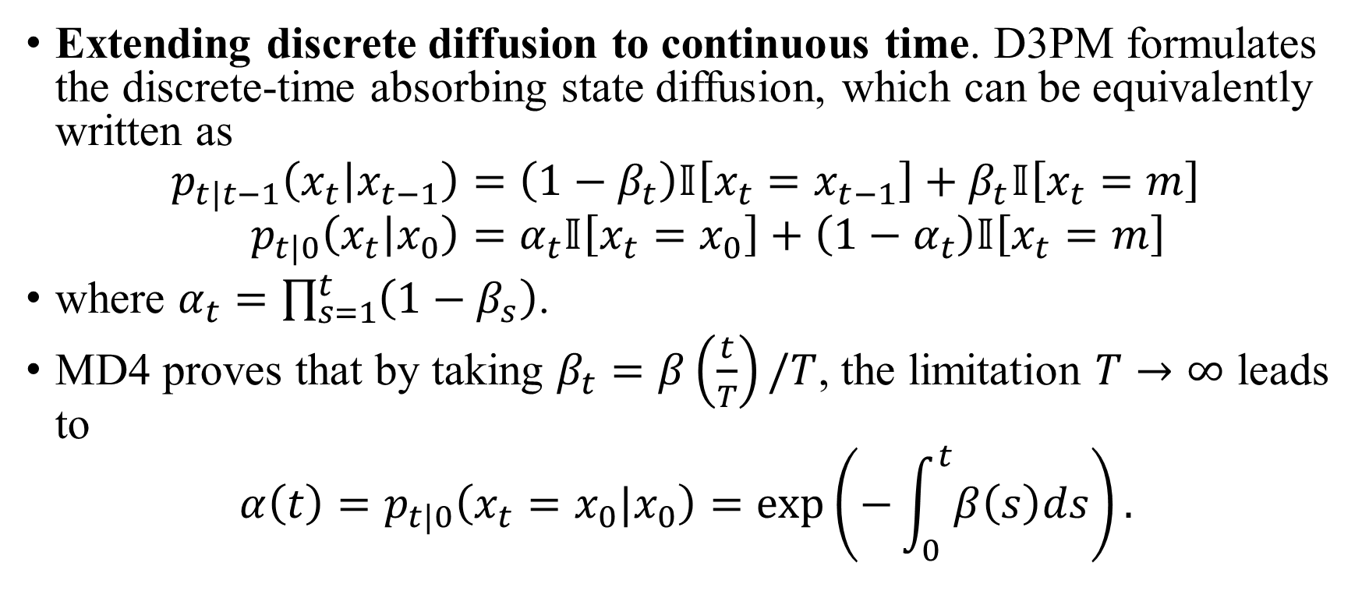
MD4: Continuous-time Absorbing State
Extending discrete diffusion to continuous time. D3PM formulates the discrete-time absorbing state diffusion, which can be equivalently written as
$$p_{t|t−1}\left(x_{t} | x_{t−1}\right)=\left(1−β_{t}\right)𝕀\left[x_{t}=x_{t−1}\right]+β_{t}𝕀\left[x_{t}=m\right] \\ p_{t|0}\left(x_{t} | x_{0}\right)=α_{t}𝕀\left[x_{t}=x_{0}\right]+\left(1−α_{t}\right)𝕀\left[x_{t}=m\right]$$
where $α_{t}=\prod_{s=1}^{t}{\left(1−β_{s}\right)}$.
MD4 proves that by taking $β_{t}=β\left(\frac{t}{T}\right)/T$, the limitation $T→∞$ leads to
$$α\left(t\right)=p_{t|0}\left(x_{t}=x_{0}|x_{0}\right)=\exp\left(−\int_{0}^{t}{β\left(s\right)ds}\right).$$

Slide 46
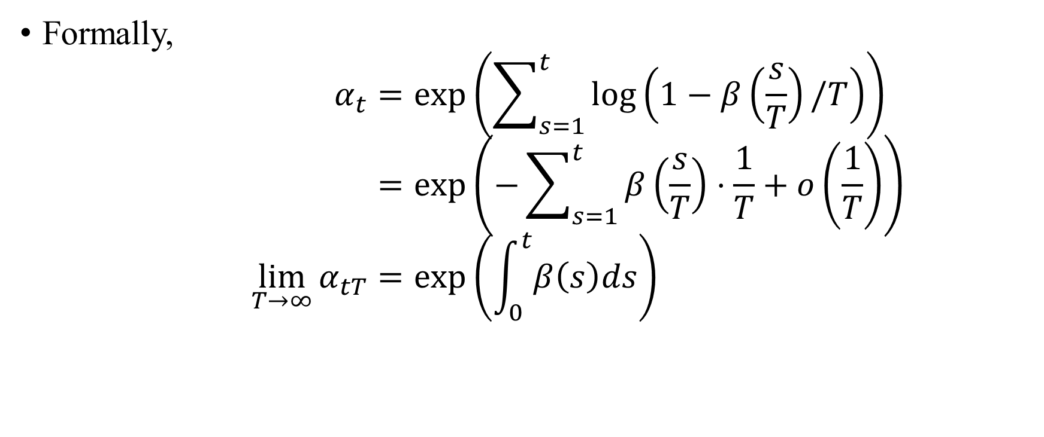
MD4: Continuous-time Absorbing State
Formally,
$$α_{t}=\exp\left(\sum_{s=1}^{t}{\log\left(1−β\left(\frac{s}{T}\right)/T\right)}\right) \\ =\exp\left(−\sum_{s=1}^{t}{β\left(\frac{s}{T}\right)⋅\frac{1}{T}}+o\left(\frac{1}{T}\right)\right) \\ \lim_{T→∞}{α_{tT}}=\exp\left(\int_{0}^{t}{β\left(s\right)ds}\right)$$

Slide 47
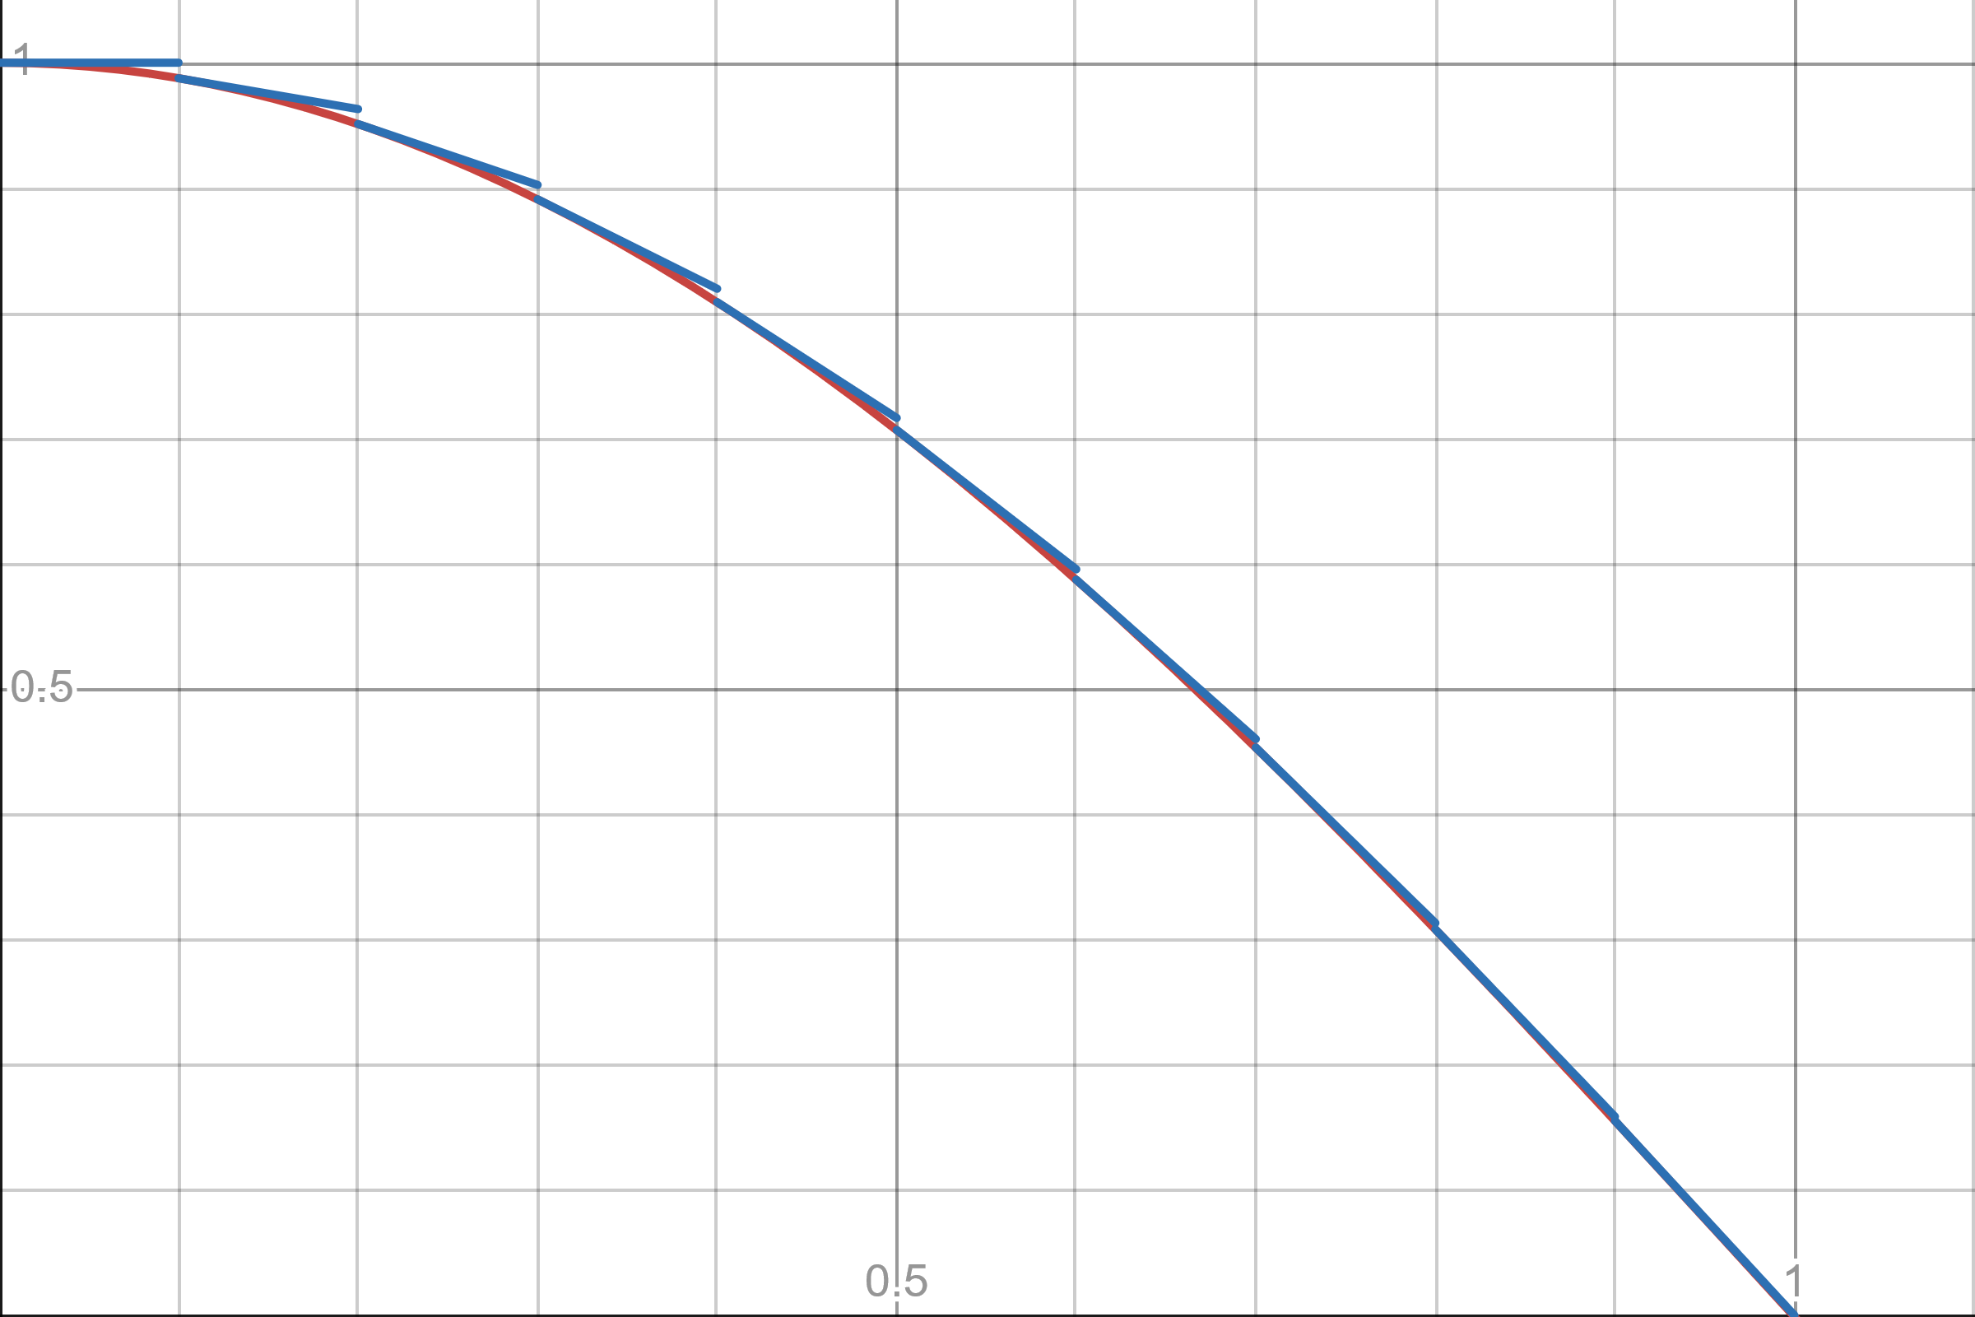


MD4: Continuous-time Absorbing State
$α_{t}=\exp\left(−\sum_{s=1}^{t}{β\left(\frac{s}{T}\right)⋅\frac{1}{T}}+o\left(\frac{1}{T}\right)\right)$.
We can interpret $β\left(t\right)$ as the (negative) rate and $\log{α\left(t\right)}=−\int_{0}^{t}{β\left(s\right)ds}$ as the distance.
The red curve is $\log{α\left(t\right)}$. The slopes of the blue lines are $−β\left(t/T\right)$. There are small gaps between the blue lines and the red curve, which is captured by $o\left(\frac{1}{T}\right)$.

Slide 48
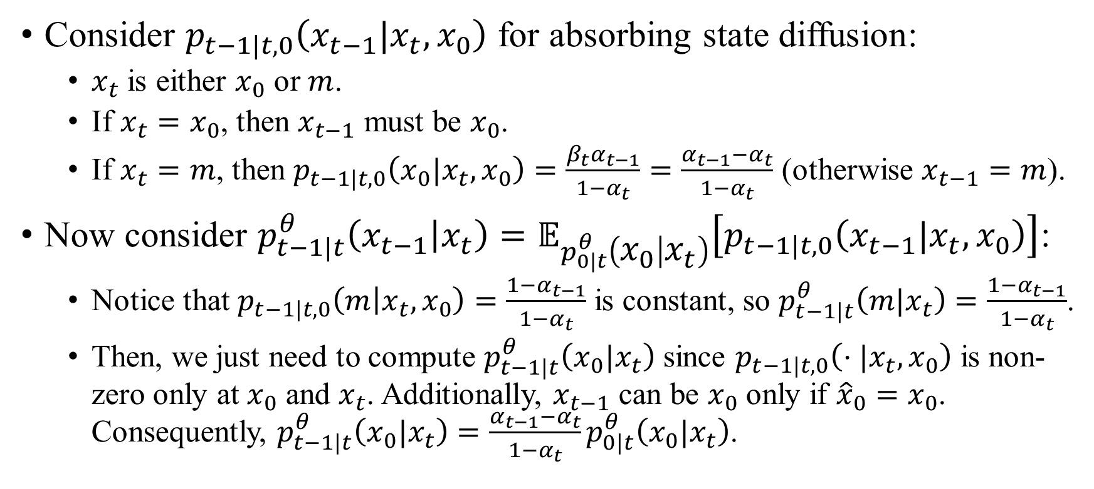
MD4: Simplify ELBO
Consider $p_{t−1|t,0}\left(x_{t−1}|x_{t},x_{0}\right)$ for absorbing state diffusion:
$x_{t}$ is either $x_{0}$ or $m$.
If $x_{t}=x_{0}$, then $x_{t−1}$ must be $x_{0}$.
If $x_{t}=m$, then $p_{t−1|t,0}\left(x_{0}|x_{t},x_{0}\right)=\frac{β_{t}α_{t−1}}{1−α_{t}}=\frac{α_{t−1}−α_{t}}{1−α_{t}}$ (otherwise $x_{t−1}=m$).
Now consider $p_{t−1|t}^{θ}\left(x_{t−1} | x_{t}\right)=𝔼_{p_{0|t}^{θ}\left(x_{0} | x_{t}\right)}\left[p_{t−1|t,0}\left(x_{t−1}|x_{t},x_{0}\right)\right]$:
Notice that $p_{t−1|t,0}\left(m | x_{t},x_{0}\right)=\frac{1−α_{t−1}}{1−α_{t}}$ is constant, so $p_{t−1|t}^{θ}\left(m|x_{t}\right)=\frac{1−α_{t−1}}{1−α_{t}}$.
Then, we just need to compute $p_{t−1|t}^{θ}\left(x_{0}|x_{t}\right)$ since $p_{t−1|t,0}\left(⋅|x_{t},x_{0}\right)$ is non-zero only at $x_{0}$ and $x_{t}$. Additionally, $x_{t−1}$ can be $x_{0}$ only if ${\hat{x}}_{0}=x_{0}$. Consequently, $p_{t−1|t}^{θ}\left(x_{0}|x_{t}\right)=\frac{α_{t−1}−α_{t}}{1−α_{t}}p_{0|t}^{θ}\left(x_{0}|x_{t}\right)$.

Slide 49
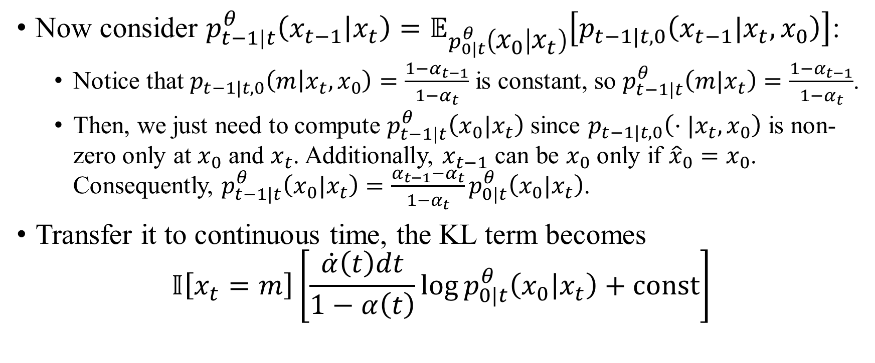
MD4: Simplify ELBO
Now consider $p_{t−1|t}^{θ}\left(x_{t−1} | x_{t}\right)=𝔼_{p_{0|t}^{θ}\left(x_{0} | x_{t}\right)}\left[p_{t−1|t,0}\left(x_{t−1}|x_{t},x_{0}\right)\right]$:
Notice that $p_{t−1|t,0}\left(m | x_{t},x_{0}\right)=\frac{1−α_{t−1}}{1−α_{t}}$ is constant, so $p_{t−1|t}^{θ}\left(m|x_{t}\right)=\frac{1−α_{t−1}}{1−α_{t}}$.
Then, we just need to compute $p_{t−1|t}^{θ}\left(x_{0}|x_{t}\right)$ since $p_{t−1|t,0}\left(⋅|x_{t},x_{0}\right)$ is non-zero only at $x_{0}$ and $x_{t}$. Additionally, $x_{t−1}$ can be $x_{0}$ only if ${\hat{x}}_{0}=x_{0}$. Consequently, $p_{t−1|t}^{θ}\left(x_{0}|x_{t}\right)=\frac{α_{t−1}−α_{t}}{1−α_{t}}p_{0|t}^{θ}\left(x_{0}|x_{t}\right)$.
Transfer it to continuous time, the KL term becomes
$$𝕀\left[x_{t}=m\right]\left[\frac{\dot{α}\left(t\right)dt}{1−α\left(t\right)}\log{p_{0|t}^{θ}\left(x_{0} | x_{t}\right)}+const\right]$$

Slide 50

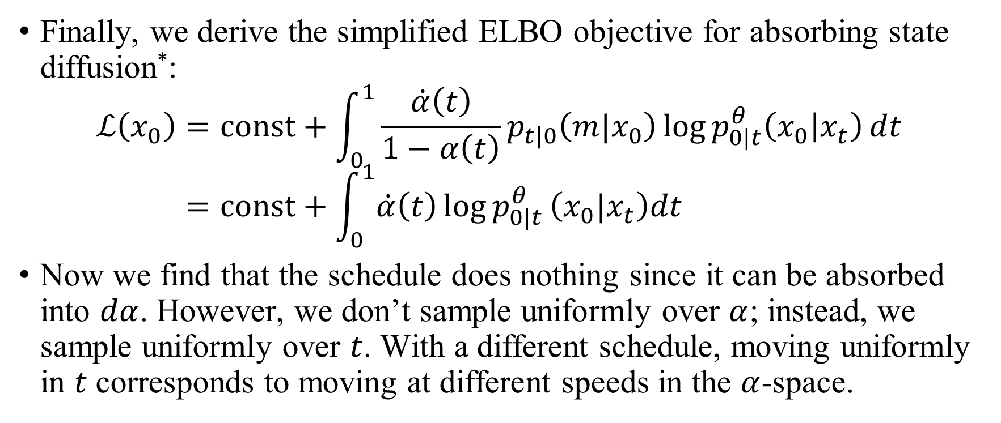
MD4: Analysis about the schedule
Finally, we derive the simplified ELBO objective for absorbing state diffusion*:
$$ℒ\left(x_{0}\right)=const+\int_{0}^{1}{\frac{\dot{α}\left(t\right)}{1−α\left(t\right)}p_{t|0}\left(m|x_{0}\right)\log{p_{0|t}^{θ}\left(x_{0} | x_{t}\right)}dt} \\ =const+\int_{0}^{1}{\dot{α}\left(t\right)\log{p_{0|t}^{θ}}\left(x_{0}|x_{t}\right)dt}$$
Now we find that the schedule does nothing since it can be absorbed into $dα$. However, we don’t sample uniformly over $α$; instead, we sample uniformly over $t$. With a different schedule, moving uniformly in $t$ corresponds to moving at different speeds in the $α$-space.
* I extend the formula by expanding $p_{t|0}\left(m|x_{0}\right)$.

Slide 51
Concrete Score Matching
Diffusion
ELBO
Score Matching
CDCD
SEDD
RADD
D3PM
Discrete Flow Matching
DiffusionBERT
GENIE
MD4
LLaDA
Concrete Score Matching
Plaid

Slide 52

Concrete Score Matching
Recall score matching – once we have $∇_{x}\log{p\left(x\right)}$, we can sample from $p\left(x\right)$. However, on discrete spaces, we can’t define $∇_{x}$. Concrete score matching is score matching on discrete spaces.
Before introducing concrete score matching, let’s consider a question:
We have the following diffusion forward process
$$p_{t}=Q_{t}p_{t−1}.$$
We know the noise distribution $p_{T}$.
Why can’t we just compute $p_{t−1}=Q_{t}^{−1}p_{t}$?

Slide 53

Concrete Score Matching
Before introducing concrete score matching, let’s consider a question:
We have the following diffusion forward process
$$p_{t}=Q_{t}p_{t−1}.$$
We know the noise distribution $p_{T}$.
Why can’t we just compute $p_{t−1}=Q_{t}^{−1}p_{t}$?
There are many misunderstandings:
We don’t really know $p_{T}$ – $p_{T|0}$ is close to pre-defined noise distribution but actually, $p_{T}\left(x_{T}\right)=𝔼_{p_{0}\left(x_{0}\right)}p\left(x_{T}|x_{0}\right)$.
If we force $p_{T|0}$ to be exactly the pre-defined noise distribution, we will find $Q_{T}$ not invertible (for absorbing state, $Q_{T}=m1^{T}$, and for uniform, $Q_{T}=\frac{1}{d}11^{T}$.

Slide 54

Concrete Score Matching
Then, another question:
We assume $Q_{t}$ is invertible.
Though $p_{T}$ is not exactly the noise distribution, they are similar. We can sample $x_{T}$ from the noise distribution and assume $x_{T}∼p_{T}$.
We know $p_{t}=Q_{t}p_{t−1}$ defines a Markov process and we can sample $x_{t}$ given $x_{t−1}$. Can we use $p_{t−1}=Q_{t}^{−1}p_{t}$ to sample $x_{t−1}$ given $x_{t}$?

Slide 55

Concrete Score Matching
Then, another question:
We assume $Q_{t}$ is invertible.
Though $p_{T}$ is not exactly the noise distribution, they are similar. We can sample $x_{T}$ from the noise distribution and assume $x_{T}∼p_{T}$.
We know $p_{t}=Q_{t}p_{t−1}$ defines a Markov process and we can sample $x_{t}$ given $x_{t−1}$. Can we use $p_{t−1}=Q_{t}^{−1}p_{t}$ to sample $x_{t−1}$ given $x_{t}$?
We can’t, since $Q_{t}^{−1}$ does not model a Markov process – it may have negative terms and its columns don’t sum up to 1.
Our target is to find a Markov process to sample $x_{t−1}$ given $x_{t}$.

Slide 56

Concrete Score Matching
Our target is to find a Markov process to sample $x_{t−1}$ given $x_{t}$.
It is given by Bayes’ theorem:
$$p_{t−1|t}\left(x_{t−1} | x_{t}\right)=\frac{p_{t−1}\left(x_{t−1}\right)}{p_{t}\left(x_{t}\right)}⋅p_{t|t−1}\left(x_{t}|x_{t−1}\right).$$
Transfer it to continuous time:
$$dp_{t}=Q_{t}dtp_{t} \\ Q_{t}\left(x→y\right)≜\left\{\begin{aligned}\lim_{Δt→+0}{\frac{p_{t+Δt|t}\left(y|x\right)}{Δt}} if y≠x \\ \lim_{Δt→+0}{\frac{p_{t+Δt|t}\left(x | x\right)−1}{Δt}} if y=x\end{aligned}\right.$$

Slide 57

Concrete Score Matching
$Q_{t}$ is called the rate matrix. Obviously,
$$∀x,\sum_{y}{Q_{t}\left(x→y\right)}=0.$$
The reverse process is
$${\overline{Q}}_{t}\left(y→x\right)=\lim_{Δt→+0}{p_{t|t+Δt}\left(x|y\right)}=\frac{p_{t}\left(y\right)}{p_{t}\left(x\right)}Q_{t}\left(x→y\right), (x≠y)$$
For $x=y$, ${\overline{Q}}_{t}\left(y→x\right)=−\sum_{z≠y}{{\overline{Q}}_{t}\left(y→z\right)}$. Then, we can simulate the Markov process from $t=1$ to $t=0$.
$$dp_{t}={\overline{Q}}_{t}dtp_{t}$$

Slide 58

Concrete Score Matching
$${\overline{Q}}_{t}\left(y→x\right)=\frac{p_{t}\left(y\right)}{p_{t}\left(x\right)}Q_{t}\left(x→y\right)$$
The ratio $\frac{p_{t}\left(y\right)}{p_{t}\left(x\right)}$ is called the concrete score. It is also scale-invariant.
Concrete score matching is to fit $s_{t}^{θ}\left(y,x\right)$ to $\frac{p_{t}\left(y\right)}{p_{t}\left(x\right)}$. Similar to score matching, we don’t know $p_{t}\left(y\right)$ and $p_{t}\left(x\right)$; in practice, we fit $s_{t}^{θ}\left(y,x\right)$ to $\frac{p_{t|0}\left(y | x_{0}\right)}{p_{t|0}\left(x | x_{0}\right)}$ with $x_{0}∼p_{0|t}\left(x_{0} | x\right)$*.
$$ℒ=\int_{0}^{1}{𝔼_{x_{0}∼𝒟}𝔼_{p_{t|0}\left(x_{t}|x_{0}\right)}\left[\sum_{{y≠x}_{t}}{{\left(s_{t}^{θ}\left(y,x_{t}\right)−\frac{p_{t|0}\left(y | x_{0}\right)}{p_{t|0}\left(x_{t}|x_{0}\right)}\right)}^{2}}\right]}.$$
* I’m not sure whether it is $p_{0|t}\left(x_{0}|x\right)$ or $p_{0|t}\left(x_{0}|y\right)$. Maybe both are acceptable.

Slide 59

Concrete Score Matching
Finally, let’s consider how to sample $x_{0}$ given ${\overline{Q}}_{t}$ and $x_{1}∼p_{1}$.
Notice that $p_{t−Δt|t}\left(\hat{x} | x_{t}\right)={\overline{Q}}_{t}\left(x_{t}→\hat{x}\right)Δt+o\left(Δt\right)$, we can just assume that
$$p_{t−Δt|t}\left(\hat{x}|x_{t}\right)≈Δt⋅{\overline{Q}}_{t}\left(x_{t}→\hat{x}\right)$$
$\hat{x}$ may remain the same as $x_{t}$, with a probability of
$$1−\sum_{\hat{x}≠x_{t}}{Δt⋅\overline{Q}\left(x_{t}→\hat{x}\right)}$$
We gradually increase $Δt$ until $x_{t}$ is denoised.

Slide 60
SEDD
Diffusion
ELBO
Score Matching
CDCD
SEDD
RADD
D3PM
Discrete Flow Matching
DiffusionBERT
GENIE
MD4
LLaDA
Concrete Score Matching
Plaid
Discrete Diffusion Modeling by Estimating the Ratios of the Data Distribution

Slide 61


SEDD: Preliminary
Conventional score matching requires special techniques to estimate likelihood. SEDD proposes a new objective to learn the concrete score, which also serves as a lower bound of the log likelihood.
Bregman divergence $D_{f}\left(x,y\right)$ is defined for vectors (or scalars). Given a convex $f$,
$$D_{f}\left(x,y\right)=f\left(x\right)−f\left(y\right)−\left\langle ∇f\left(y\right),x−y\right\rangle .$$
is non-negative. (The green segment in the figure).

Slide 62

SEDD: Refined Objective
Let $s_{t}^{∗}\left(y,x\right)=p_{t}\left(y\right)/p_{t}\left(x\right)$. I omit the condition $x_{0}$ for convenience.
SEDD replaces the L2 term with the Bregman divergence with $f=−log$.
$$ℒ_{SE}=\int_{0}^{1}{𝔼_{x_{t}}\left[\sum_{\hat{x}≠x_{t}}{w_{x_{t},\hat{x}}^{t}}s_{t}^{∗}\left(\hat{x},x\right)\left(\log{s_{t}^{∗}\left(\hat{x},x\right)}−\log{s_{t}^{θ}\left(\hat{x},x\right)}−\frac{s_{t}^{∗}\left(\hat{x},x\right)−s_{t}^{θ}\left(\hat{x},x\right)}{s_{t}^{∗}\left(\hat{x},x\right)}\right)\right]}dt \\ =const+\int_{0}^{1}{𝔼_{x_{t}}\left[\sum_{\hat{x}≠x_{t}}{w_{x_{t},\hat{x}}^{t}\left(s_{t}^{θ}\left(\hat{x},x\right)−s_{t}^{∗}\left(\hat{x},x\right)\log{s_{t}^{θ}(\hat{x},x)}\right)}\right]dt}$$

Slide 63

SEDD: Refined Objective
By taking $w_{x_{t},\hat{x}}^{t}=Q_{t}\left(\hat{x}→x_{t}\right)$, they derive the following objective
$$ℒ_{DWDSE}=const+\int_{0}^{1}{𝔼_{x_{t}}\left[\sum_{\hat{x}≠x_{t}}{Q_{t}\left(\hat{x}→x_{t}\right)\left(s_{t}^{θ}\left(\hat{x},x\right)−s_{t}^{∗}\left(\hat{x},x\right)\log{s_{t}^{θ}(\hat{x},x)}\right)}\right]dt}$$
They prove that
$$−\log{p_{0}^{θ}\left(x_{0}\right)≤ℒ_{DWDSE}+D_{KL}\left[p_{1|0}\left(x_{1} | x_{0}\right)\left\|p_{z}\left(x_{1}\right)\right.\right]}.$$
Another advantage of DWDSE is that it is convex to $s_{t}^{θ}$.

Slide 64

SEDD: Concrete Score for Sequences
It is too expensive to compute $p_{t}\left(y\right)/p_{t}\left(x\right)$ for all the pairs of sequences.
Notice that we define concrete score over an extremely short time interval $dt$. $x_{t+dt}$ and $x_{t}$ won’t differ too much. Moreover, since we consider each token independently, we can assume that the probability of changing two or more tokens is much lower than that of changing exactly one token.
We only computes the concrete score for $\left(x,\hat{x}\right)$ with $\hat{x}=\left(x^{1},…,{\hat{x}}^{i},…,x^{n}\right)$. For convenience, we define $s\left(x\right)∈ℝ^{n×d}$ with $s{\left(x\right)}_{i,{\hat{x}}^{i}}=p\left(\hat{x}\right)/p\left(x\right)$.

Slide 65

SEDD: Concrete Score for Sequences
It resembles the gradient $∇_{x}$, which considers a small neighborhood of $x$ – on sequence spaces, the smallest neighborhood is the sequences with one token different from $x$.
Consequently, the input and output shape of $s_{t}^{θ}$ is exactly the same as a language model.

Slide 66

SEDD: Efficient Sampling
If we use the conventional sampling, $p_{t−Δt|t}\left(\hat{x}|x_{t}\right)∝\overline{Q}\left(x_{t}→\hat{x}\right)$.
However, we only consider $\overline{Q}\left(x_{t}→\hat{x}\right)$ for $\hat{x}$ with one-token difference from $x_{t}$. Consequently, we have to sample at least $\left|x\right|$ times to get $x_{0}$.
Intuitively, we can sample each token independently, which is called $τ$-leaping strategy:
$$p_{t−Δt|t}^{i}\left({\hat{x}}^{i}|x_{t}\right)=\overline{Q}\left(x_{t}→{\hat{x}}^{i}\right).$$
It significantly affects the performance, since we may generate two conflicting tokens and we can’t modify them once they are denoised.

Slide 67

SEDD: Efficient Sampling
SEDD proposes Tweedie $τ$-leaping strategy, correcting $τ$-leaping strategy with Tweedie theorem.
Tweedie theorem suggests that, for $X_{t}∼𝒩\left(x_{t−1},σ^{2}\right)$, the center of $p\left(y | x\right)$ has a closed form:
$$∇_{x}\log{p_{t}\left(x_{t}\right)}=𝔼_{p_{t−1|t}\left(x_{t−1}|x_{t}\right)}\left[∇_{x}\log{p_{t|t−1}\left(x | x_{t−1}\right)}{\left.​\right|}_{x=x_{t}}\right] \\ =𝔼_{p_{t−1|t}\left(x_{t−1}|x_{t}\right)}\left[\frac{x_{t−1}−x_{t}}{σ^{2}}\right] \\ 𝔼_{p_{t−1|t}\left(x_{t−1}|x_{t}\right)}x_{t−1}=x_{t}+σ^{2}∇_{x}\log{p_{t}\left(x_{t}\right)}$$

Slide 68

SEDD: Efficient Sampling
Similarly, we have
$$p_{s|t}\left(x_{s}|x_{t}\right)=\frac{p_{s}\left(x_{s}\right)p_{t|s}\left(x_{t}|x_{s}\right)}{p_{t}\left(x_{t}\right)}.$$
where $p_{t}=Q_{t|s}p_{s}⇒p_{s}=Q_{t|s}^{−1}p_{t}$, $p_{s}\left(x_{s}\right)={\left(Q_{t|s}^{−1}p_{t}\right)}_{x_{s}}$. Then
$$p_{s|t}\left(x_{s}|x_{t}\right)={\left(Q_{t|s}^{−1}⋅\frac{p_{t}}{p_{t}\left(x_{t}\right)}\right)}_{x_{s}}Q_{t|s}\left(x_{t},x_{s}\right)$$
While we don’t have $p_{t}(x_{s})/p_{t}\left(x_{t}\right)$ for $\left(x_{t},x_{s}\right)$ with difference of more than one token, we can use it as a guidance to sample ${\hat{x}}^{i}$:
$$p_{t−1|t}^{i}\left({\hat{x}}^{i}|x_{t}\right)=p_{t−1|t}\left(\left(x_{t}^{1},…,{\hat{x}}^{i},…,x_{t}^{n}\right)|x_{t}\right)$$

Slide 69
LLaDA
Diffusion
ELBO
Score Matching
CDCD
SEDD
RADD
D3PM
Discrete Flow Matching
DiffusionBERT
GENIE
MD4
LLaDA
Concrete Score Matching
Plaid
Large Language Diffusion Models

Slide 70

LLaDA: Overview
Absorbing state diffusion.
Major contributions:
Scale up to 8B.
On par with or better than modern LLMs like Llama.
Instruction following for diffusion LLMs.

Slide 71

LLaDA: Re-masking
LLaDA adopts an inspiring technique: re-masking.
Notice that, for absorbing state diffusion, once a token is denoised, it can’t be modified, especially when we parameterize $p_{t−1|t}^{θ}\left(x_{t−1}|x_{t}\right)$ as $p_{t−1|t,0}\left(x_{t−1}|x_{t},{\hat{x}}_{0}^{θ}\left(x_{t}\right)\right)$.
$$p_{t−1|t,0}\left(x_{t−1} | x_{t},x_{0}\right)=\frac{p_{t|t−1}\left(x_{t}|x_{t−1}\right)p_{t−1}\left(x_{t−1}\right)}{p_{t}\left(x_{t}\right)}$$
LLaDA incorporates re-masking to enable modifying a denoised token.

Slide 72

LLaDA: Re-masking
Specifically, when denoising from time $t$ to $s$ (they adopt continuous time), it re-masks $\frac{s}{t}$ of the denoised tokens.
Random.
Lowest-$\frac{s}{t}$ confidence. It coincides with the idea of DiffusionBERT to denoise simple tokens first.

Slide 73

LLaDA: Re-masking
Semi-AR.

Slide 74
Thanks for listening!

